Slide 1
Metadata <Standards>
EDS213 - Databases & Data Management
Renata Curty
Research Data Services, UCSB Library
recurty@ucsb.edu

Slide 2
Learning Objectives
Understand the role of metadata standards in facilitating the management, discovery, interoperability, and reuse of digital resources and research data.
Recognize the importance of adhering to domain-specific metadata standards
Identify metadata standards commonly used in Earth and Environmental Sciences research.

Slide 3
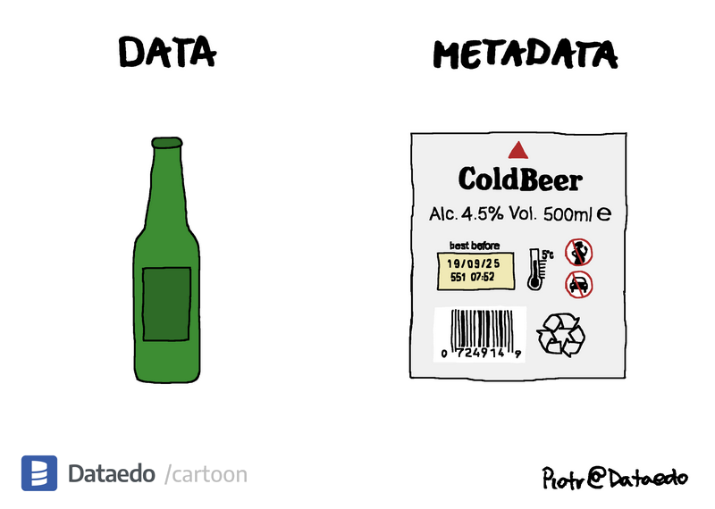
Metadata
(self-referential)
describes, explains, or provides context about data
Descriptors that help understanding what data are, where to find them, how to access them, right to use, and more.

Slide 4
Avoid Uncertainty & Assumptions
id | stn | time | mag | depth | loc1 | loc2
001 | A1 | 04/05/26 03:12 | 4.5 | 10 | 34.05 | -118.25
002 | B2 | 04/05/26 07:28 | 3.8 | 5 | 36.77 | -119.41
003 | A1 | 04/05/26 11:55 | 5.1 | 12 | 35.68 | -117.50
time → Is this MM/DD/YY or DD/MM/YY? What timezone?
mag → Richter scale? Moment magnitude (Mw)? Something else?
depth → Kilometers or miles?
loc1 / loc2 → Latitude/longitude? Or reversed?
stn → What do station codes A1, B2 mean?
Missing precision → Depth is an integer—was it rounded?

Slide 5
Provides Contextual Information
98°F
Measured how? Under what conditions?
“The surface temperature was measured using an infrared thermopile sensor (model XYZ-IR5), mounted 3 meters above ground level, capturing data every 10 seconds. The sensor was last calibrated 3 months ago, has a known accuracy of ±0.05°F, and has been operating in an outdoor environment under partial shade for 72 hours.”
Pasquetto, I. V., Borgman, C. L., & Wofford, M. F. (2019). Uses and Reuses of Scientific Data: The Data Creators’ Advantage. Harvard Data Science Review, 1(2). https://doi.org/10.1162/99608f92.fc14bf2d

Slide 6
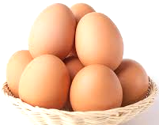
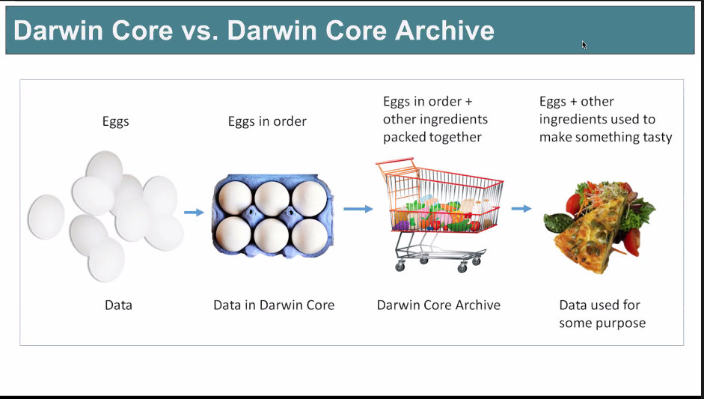
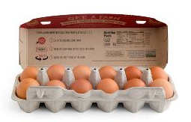
Allow for New Research
Enhanced data discovery
Improved understability and reusability
Improved data quality
Reproducibility and collaboration
Arranged, labelled and with provenance info (traceable)
Other related items packed together
You may combine them to make something tasty
Data + Rich Metadata
Data Repository
(Software/Code + Documentation
New Research Deliverables
Data

Slide 7
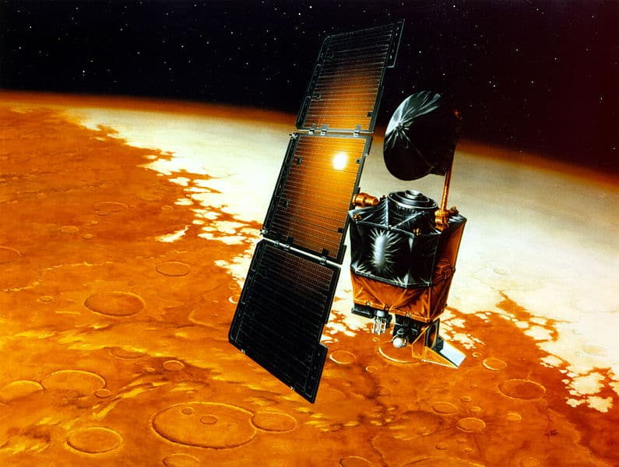
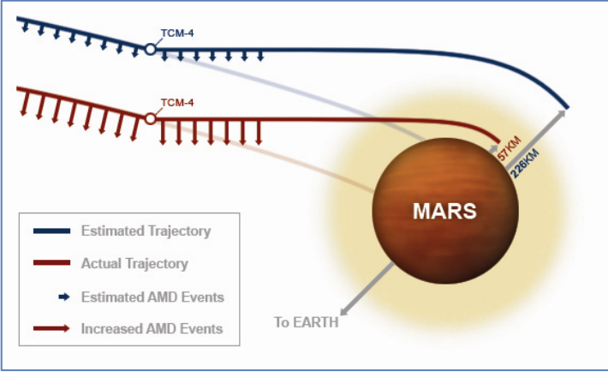
Can Prevent Losses & Disasters
NASA. (2009, August). Lost in translation: The Mars Climate Orbiter mishap (System Failure Case Studies, Vol. 3, Issue 5). https://sma.nasa.gov/docs/default-source/safety-messages/safetymessage-2009-08-01-themarsclimateorbitermishap.pdf
Lockheed Martin → thruster data in imperial (pound-force seconds)
NASA software → expected metric (newton-seconds)
Miscalculation of the orbiter's trajectory
~$600 million loss (today)
September 1999

Slide 8
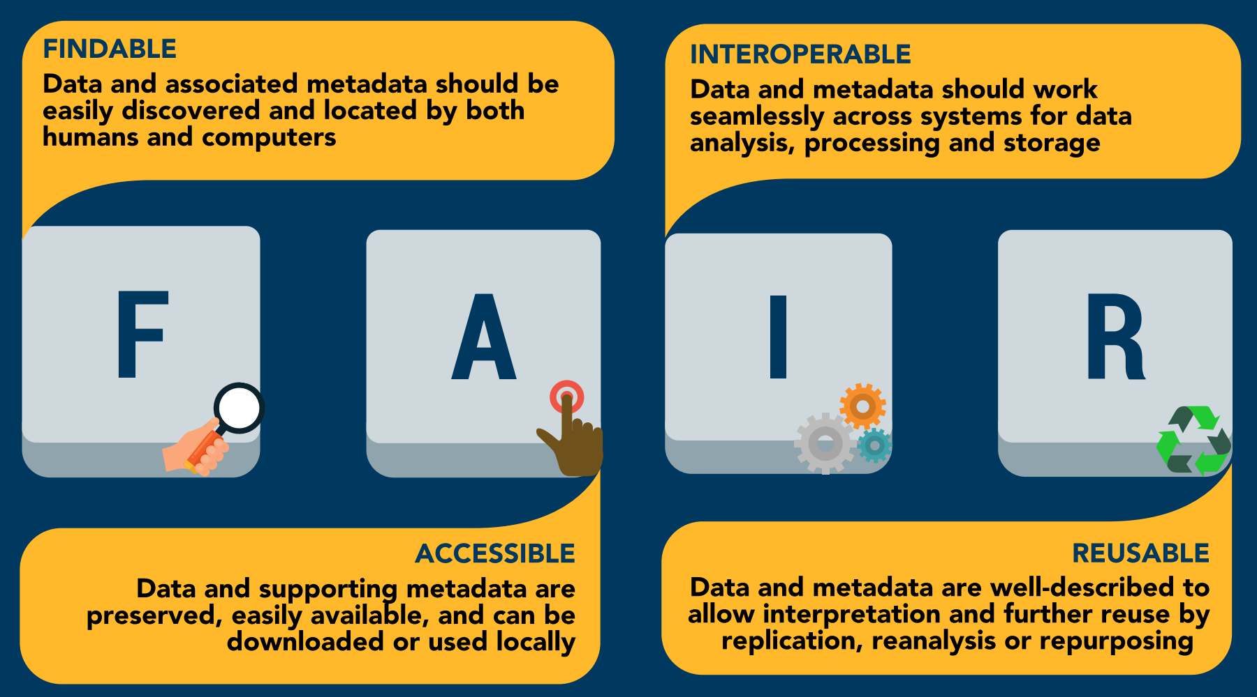
FAIR Data, Requires Metadata!
Wilkinson, M. D., Dumontier, M., Aalbersberg, I. J., Appleton, G., Axton, M., Baak, A., Blomberg, N., Boiten, J. W., da Silva Santos, L. B., Bourne, P. E., Bouwman, J., Brookes, A. J., Clark, T., Crosas, M., Dillo, I., Dumon, O., Edmunds, S., Evelo, C. T., Finkers, R., Gonzalez-Beltran, A., … Mons, B. (2016). The FAIR Guiding Principles for scientific data management and stewardship. Scientific data, 3, 160018. doi.org/10.1038/sdata.2016.18

Slide 9
Study Level Metadata
+
Data/File Level Metadata
Contextual Information: research question, goals, methodology, and overall design of the study.
Provenance: details about the data's origin, including who collected it, when, and how.
Ethical Considerations: information about any ethical protocols and approvals related to the study.
Data Description: information about the specific variables, data types, and formats used in the study.
Data Quality: details about the accuracy, reliability, and completeness of the data.
Data Structure: describes the organization and arrangement of the data, including file formats and data dictionaries.
Access and Usage: information about data access restrictions, licenses, and permitted uses.

Slide 10
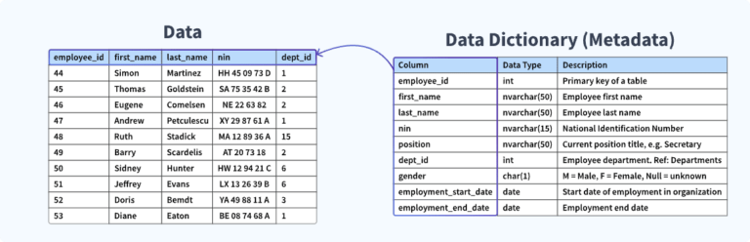
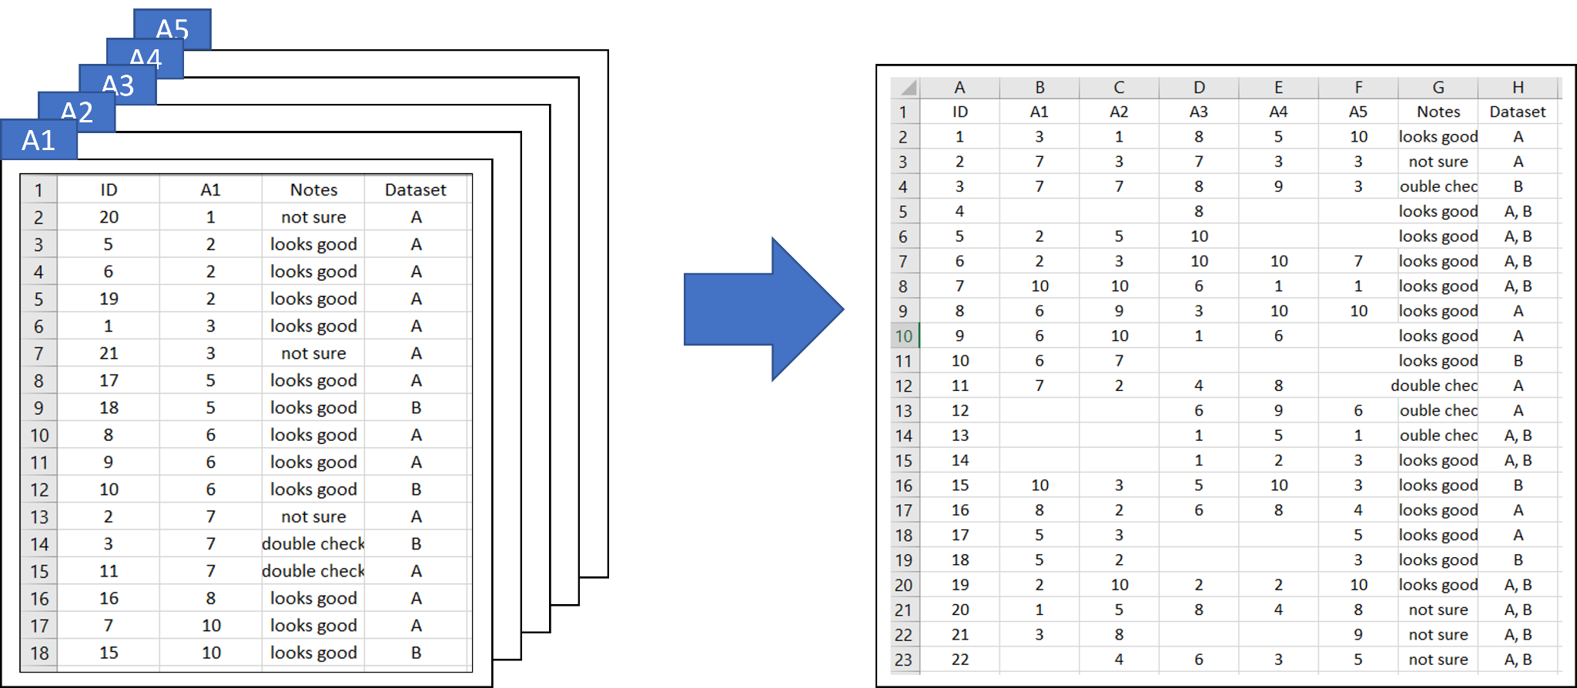

Metadata
Folder (s)
project
Store basic metadata at the file level for better portability and easy interpretability
Do not use colors or other formatting to convey meaning
Include a README file to describe multiple files and how they relate to each other

Slide 11
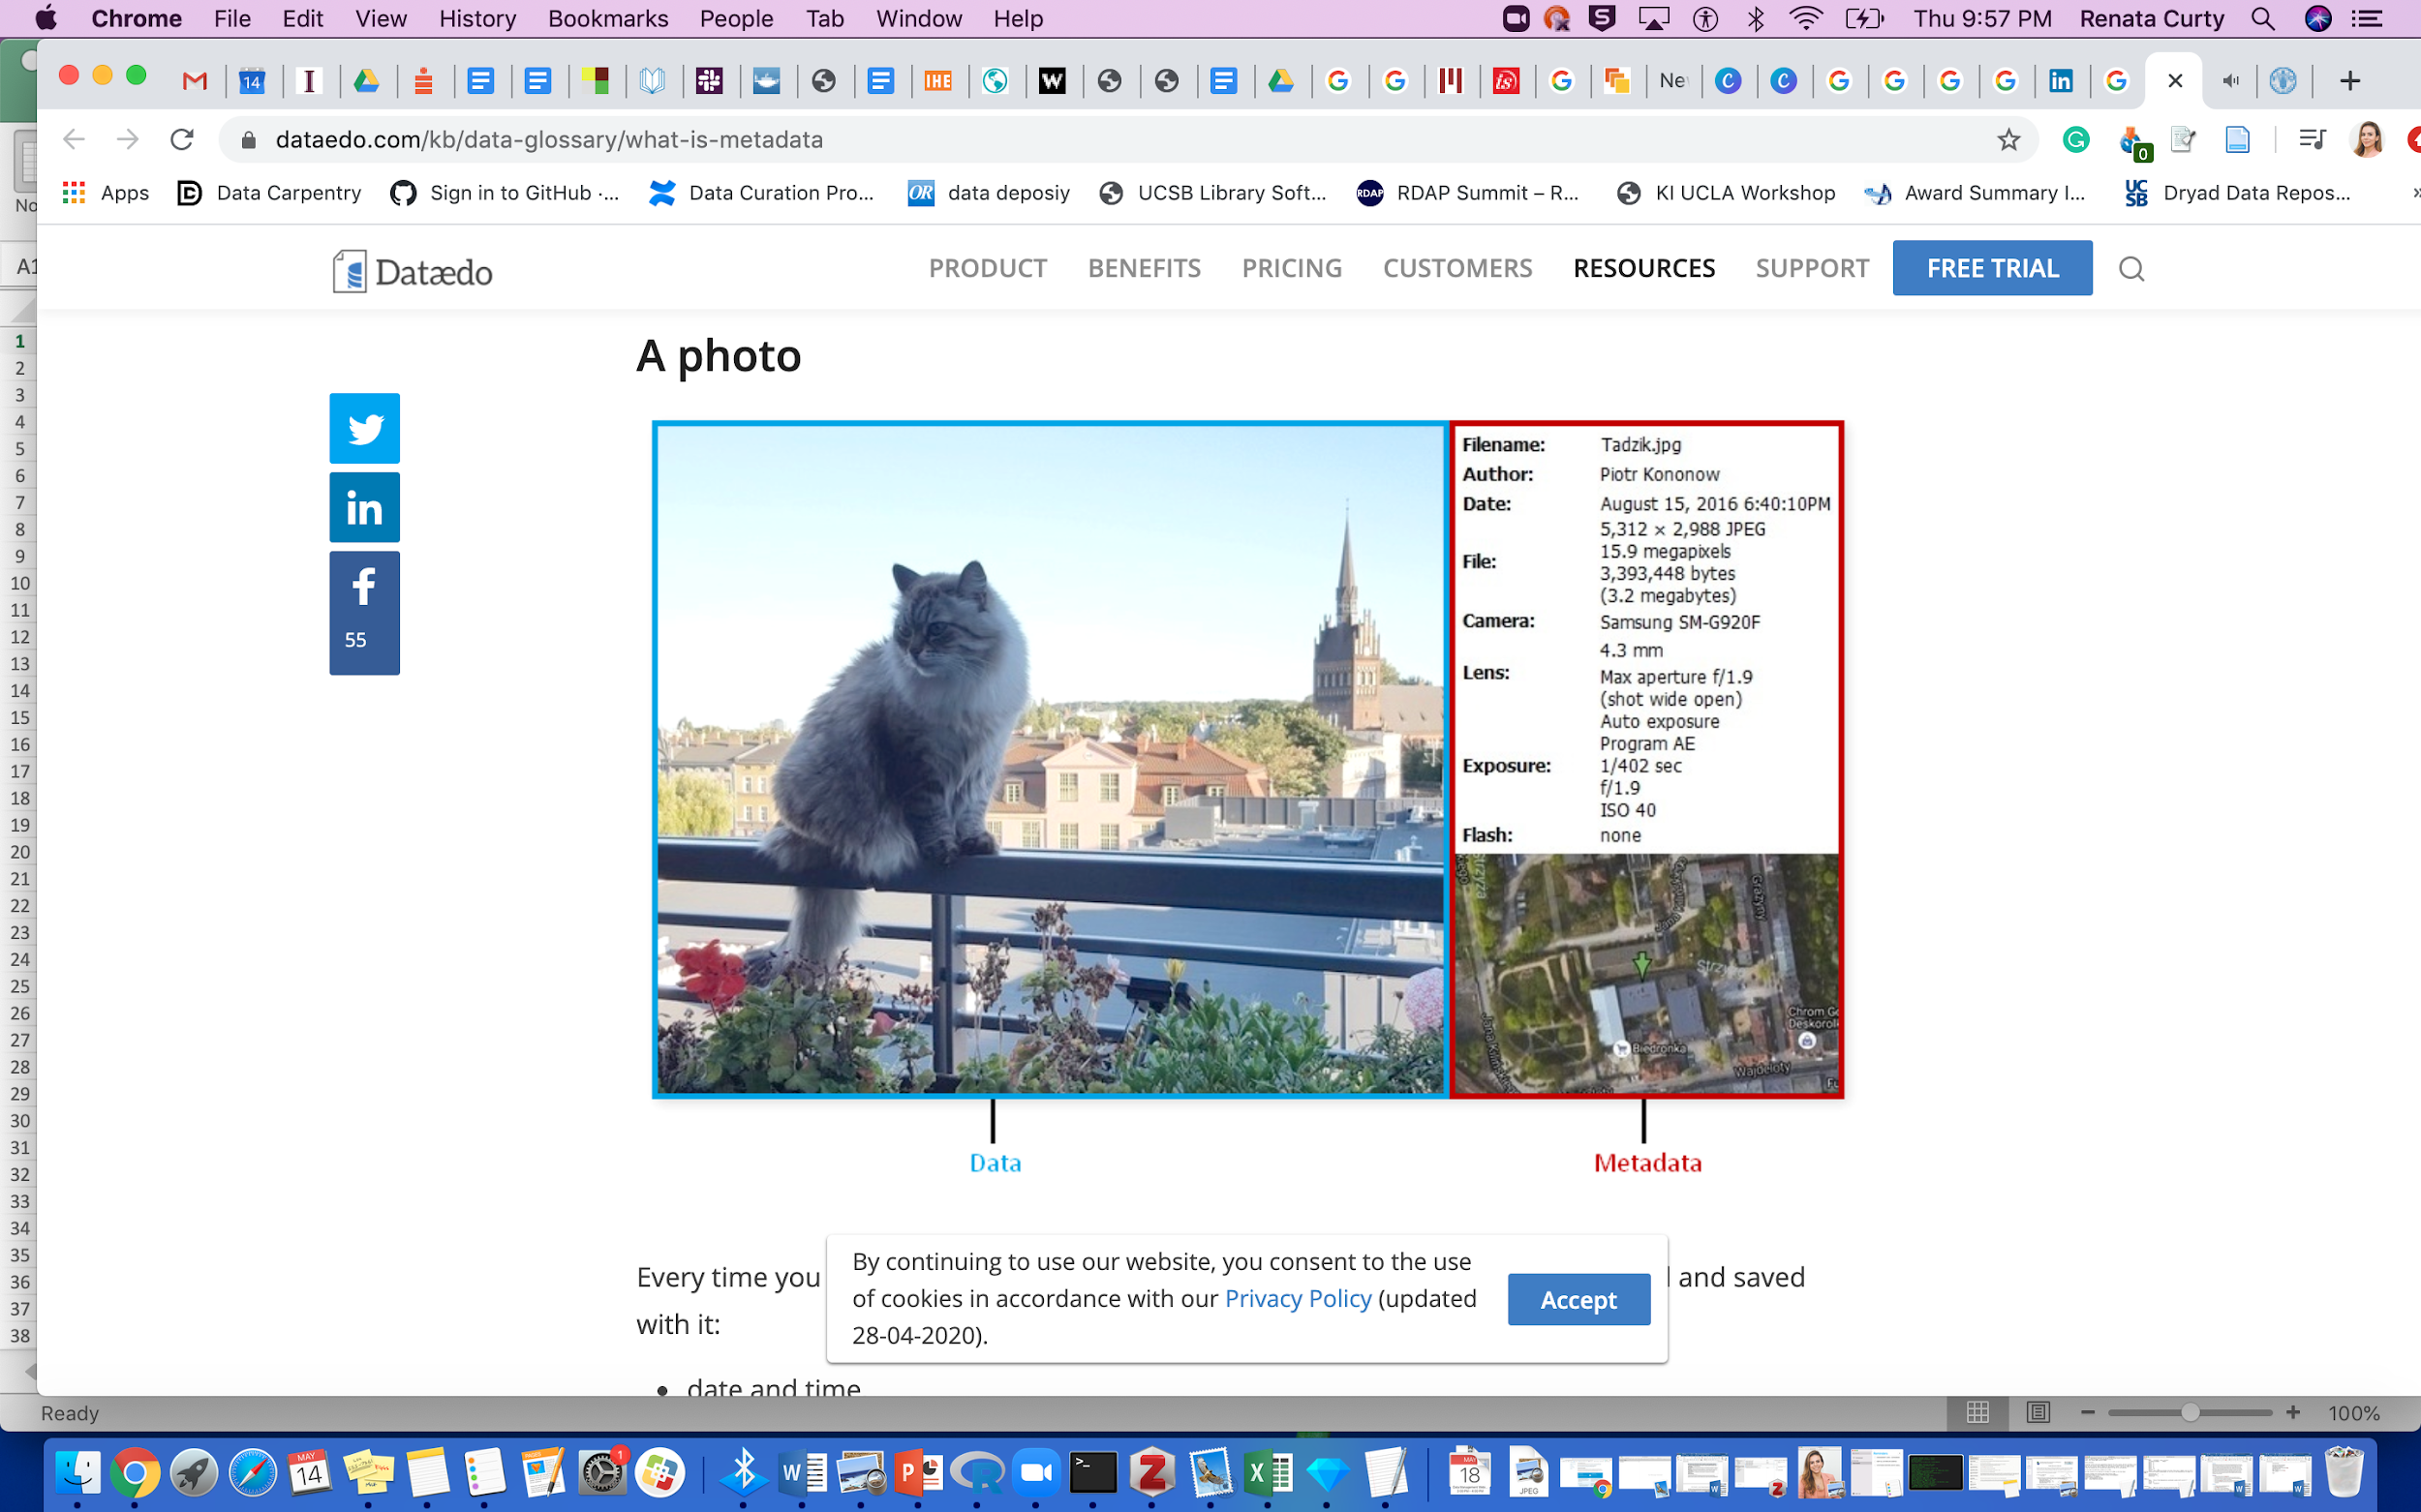
Metadata
Metadata
Data

Slide 12
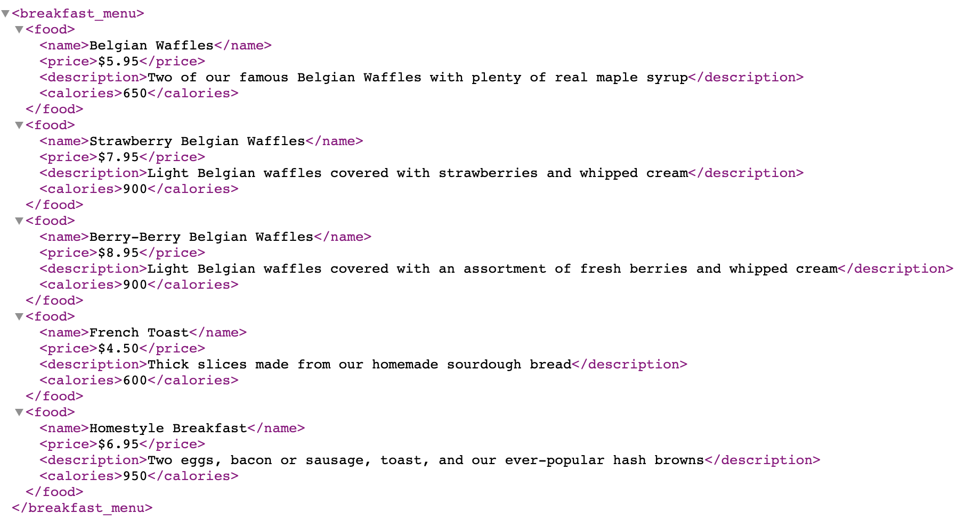
Metadata
Data
Metadata

Slide 13
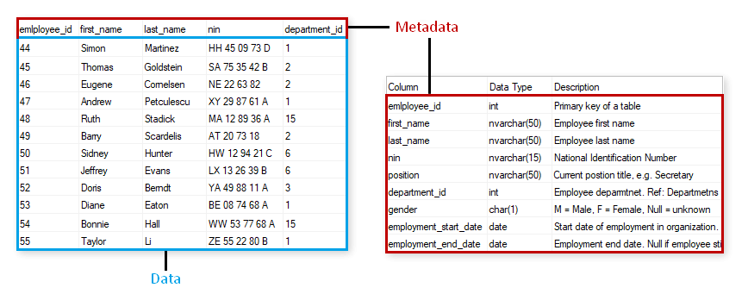
Metadata
Metadata
Data

Slide 14
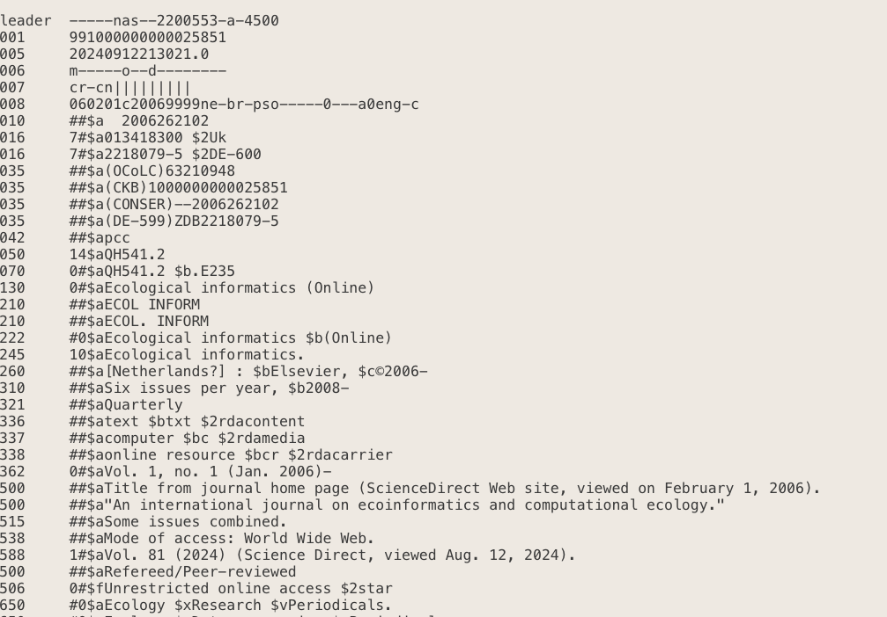
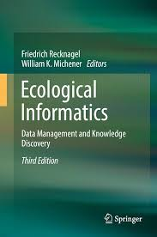
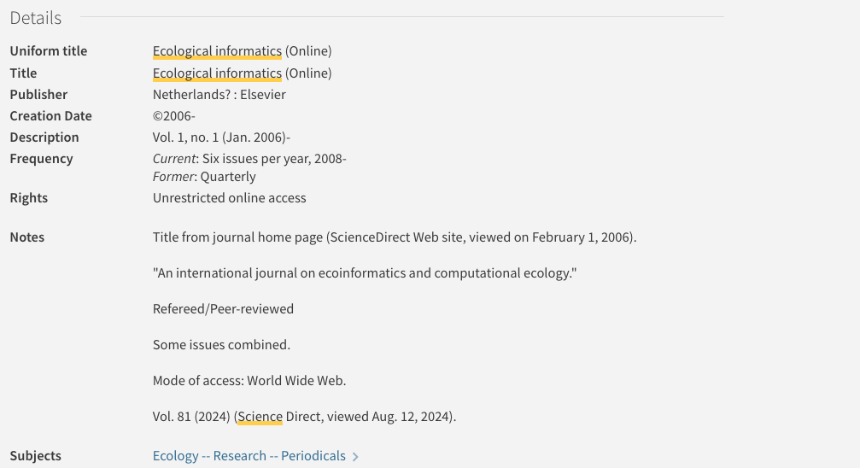
Metadata
Metadata

Slide 15
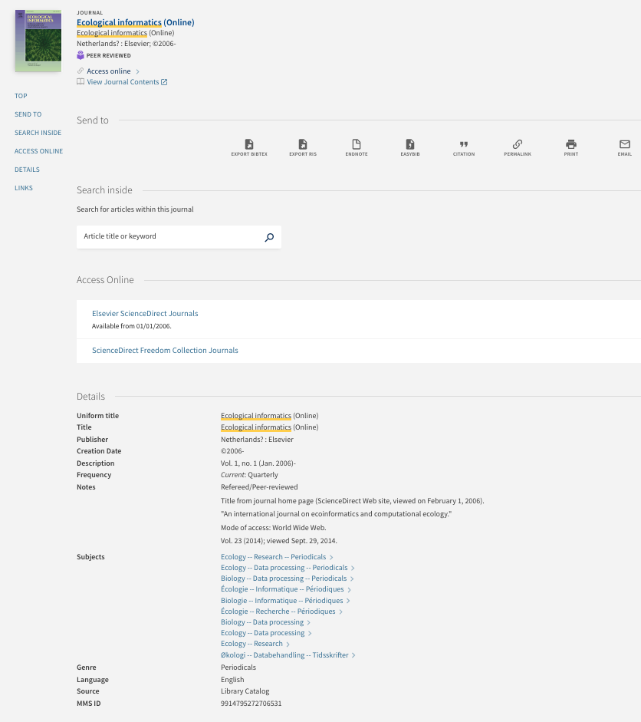
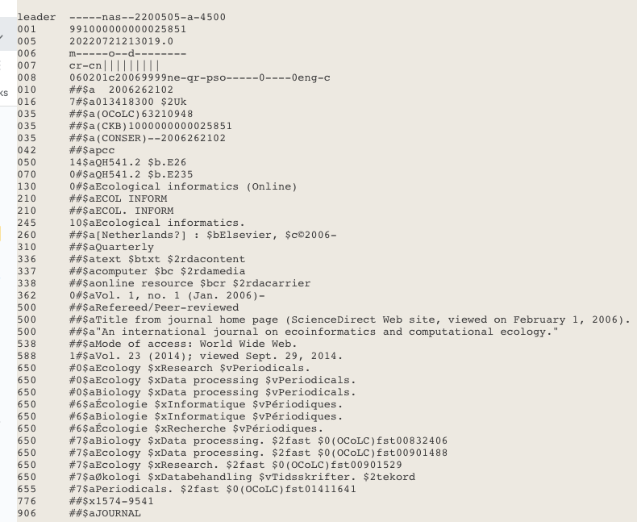
How Different?
Manually created
Human-readable
Require some work to be parsed
Machine and human-readable
No specific standard
Automatically created
Machine and human-readable
Machine and human-readable (web version)
Follows a metadata standard (MARC)

Slide 16
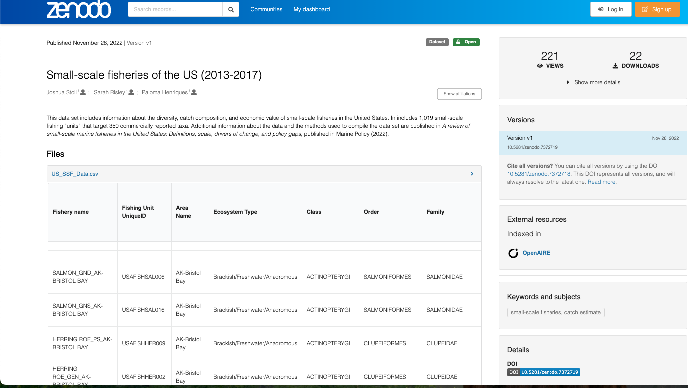
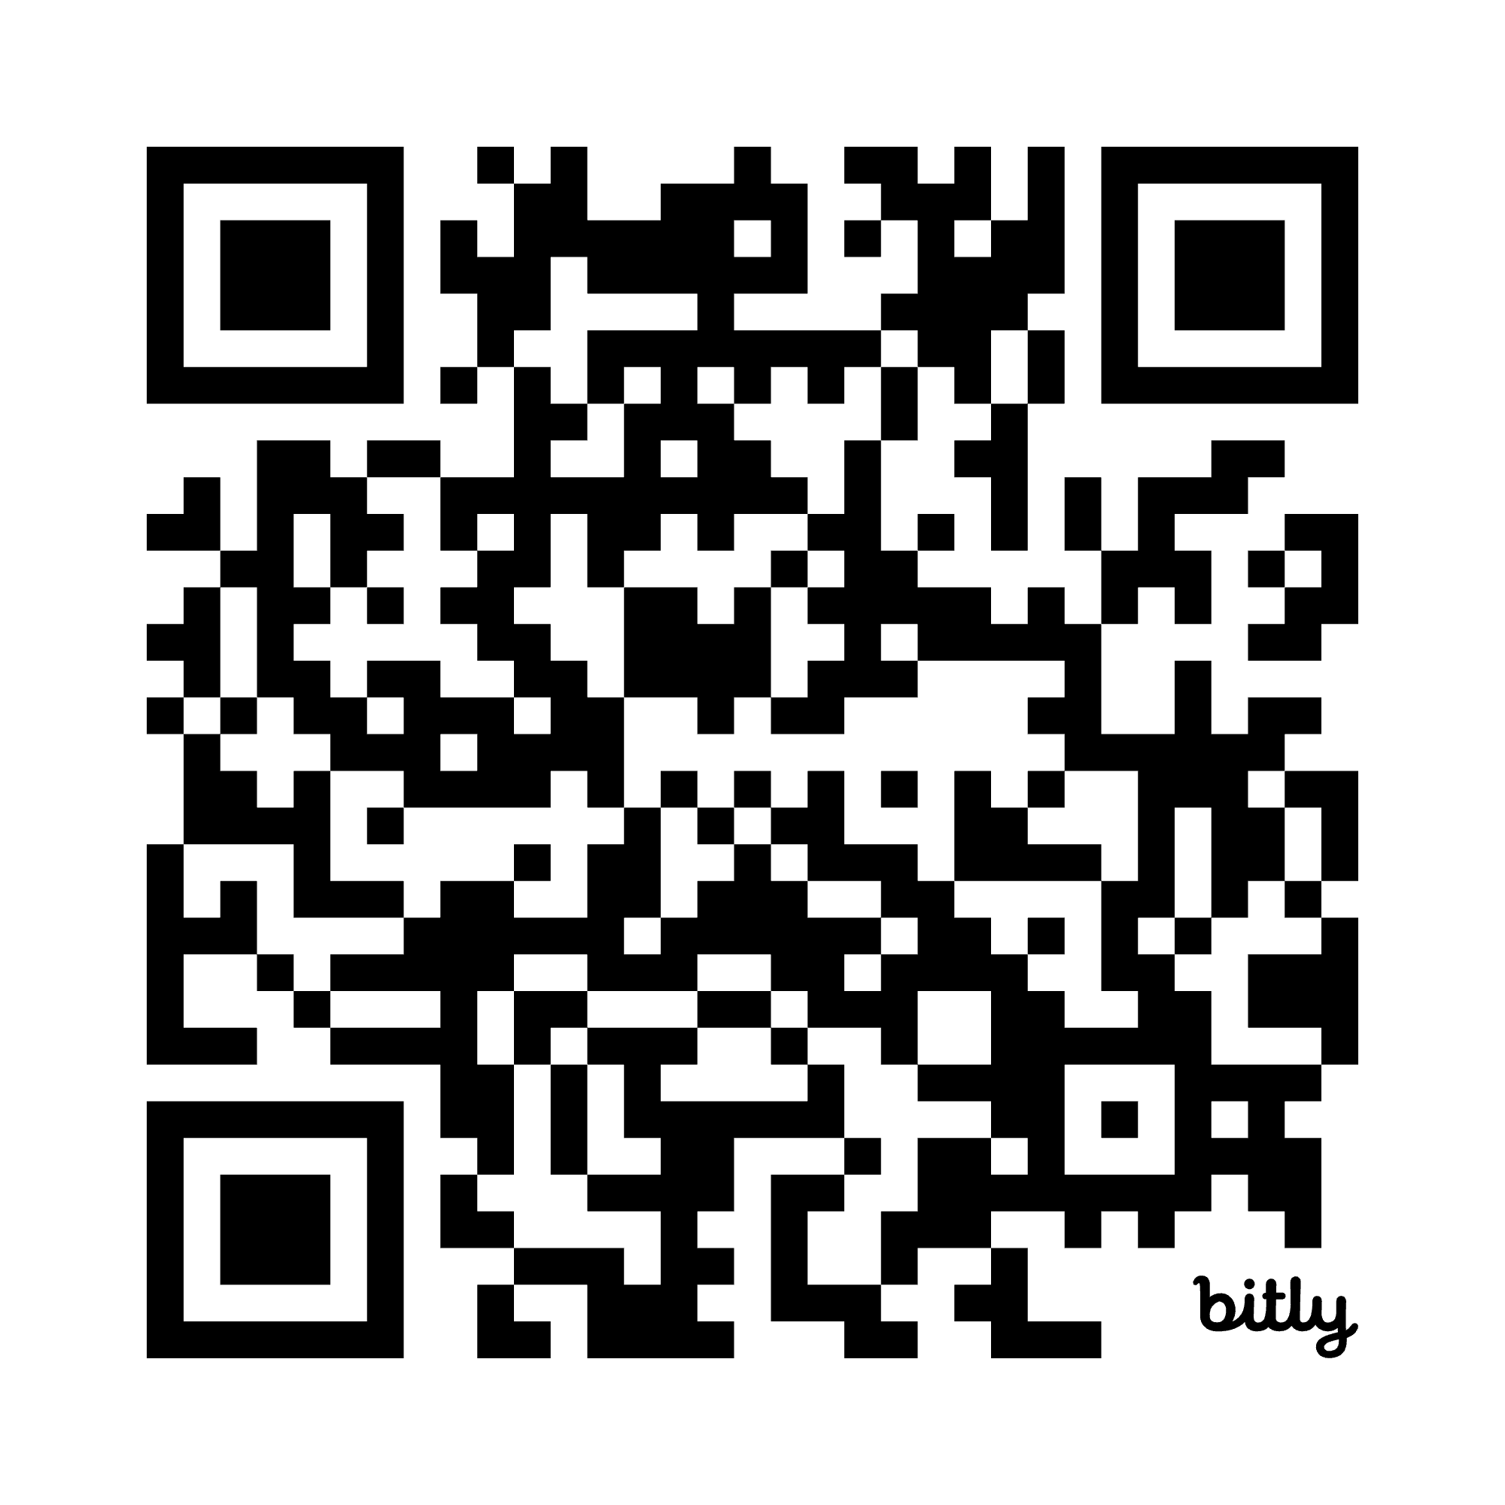
Exercise: What could be improved?
zenodo.org/records/7372719

Slide 17


Slide 18
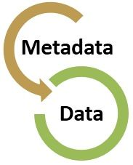
Metadata Best Practices
Keep data entry consistent (enforce rules whenever possible)
Define the parameters and the units on the parameter
Define any coded values
Describe quality flags or qualifying values
Define missing values
Choose an established metadata standard

Slide 19
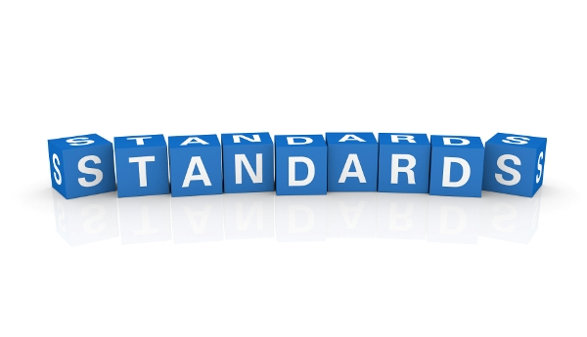
Metadata Standard
Establishes a common way of structuring and understanding data, and includes principles and implementation issues for utilizing the standard.
Provides a structure to describe and retrieve data!
Common terms to allow consistency between records
Common structure to quickly locate components
Reliable and predictable format for computer interpretation
A uniform summary description of the dataset

Slide 20
Role in Shared Infrastructure
Generates more consistent, high-quality metadata
Supports long-term access and integrity
Enables sharing and interoperability
Supports machine-readable integration
Enhances federated search and discovery

Slide 21
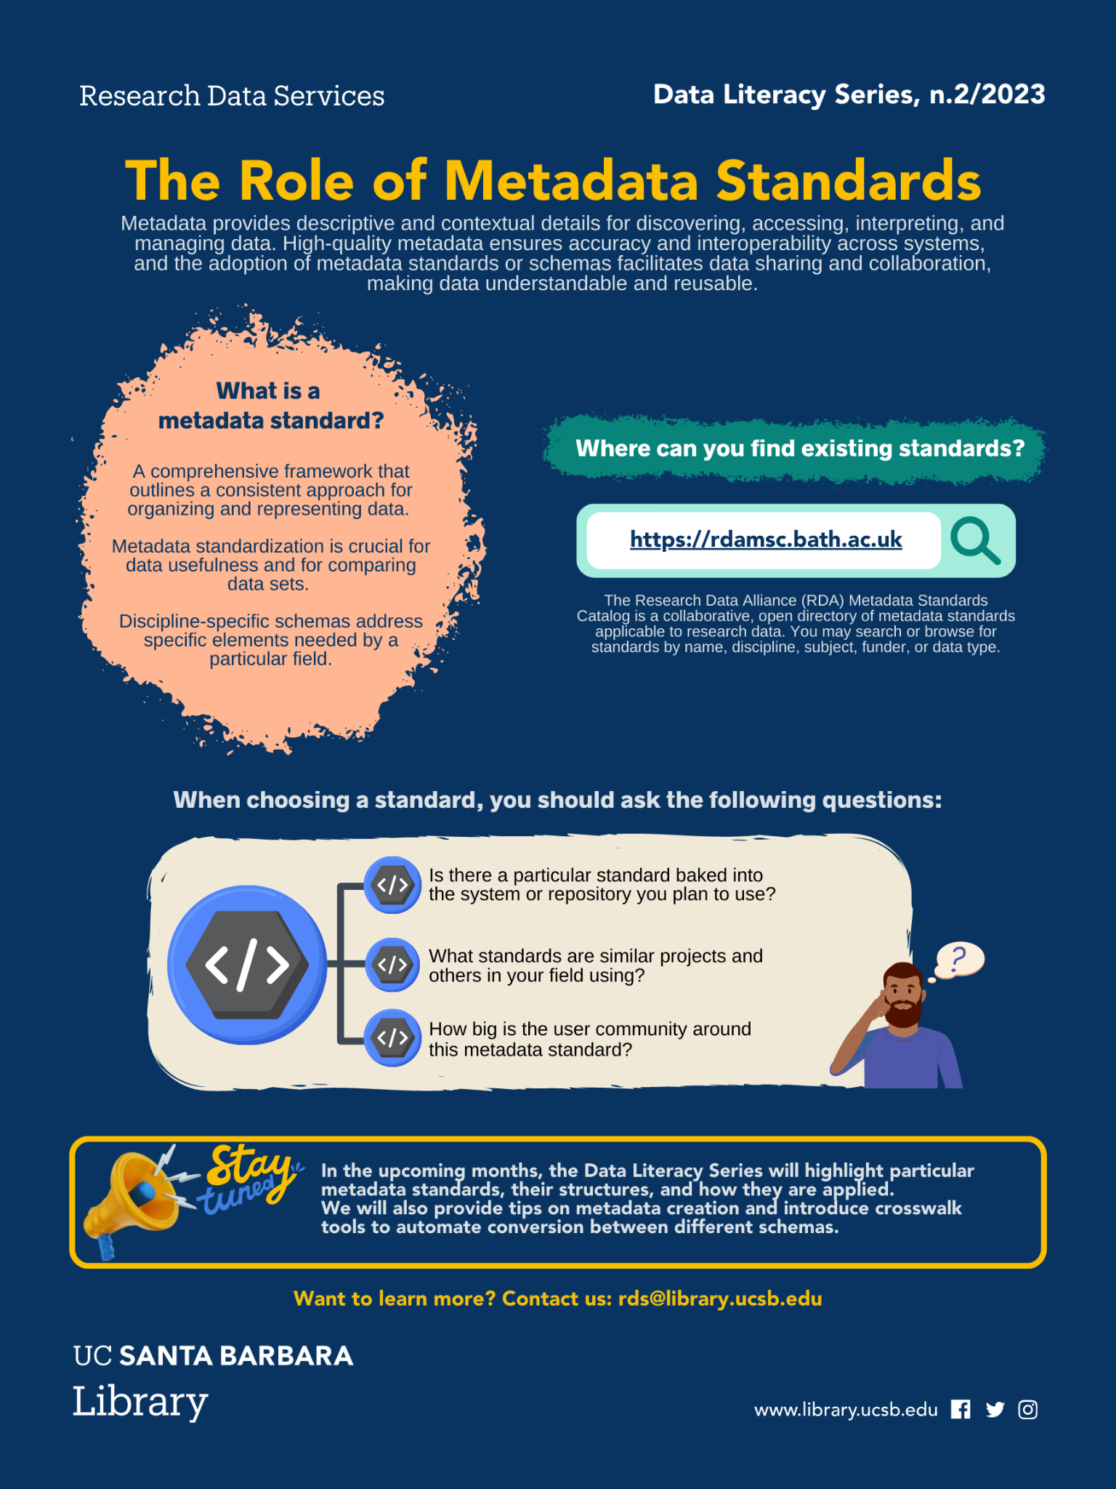
Choosing a Metadata Standard
Is there a particular standard baked into the system or repository you plan to use?
What standards are similar projects and others in your field using?
How big is the user community around this metadata standard?
perma.cc/4JP4-WSRN

Slide 22
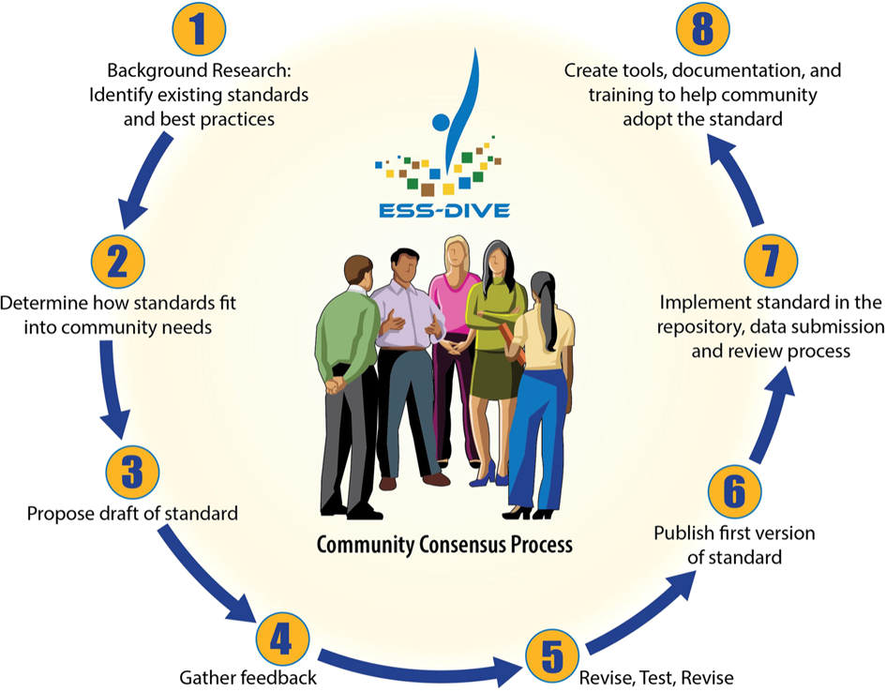
Community-Centric Initiatives
Guidelines & Templates
Metadata Profiles
Metadata Crosswalks
Archiving Requirements (Repository)
Crystal-Ornelas, R., Varadharajan, C., O’Ryan, D. et al. Enabling FAIR data in Earth and environmental science with community-centric (meta)data reporting formats. Sci Data 9, 700 (2022). https://doi.org/10.1038/s41597-022-01606-w

Slide 23
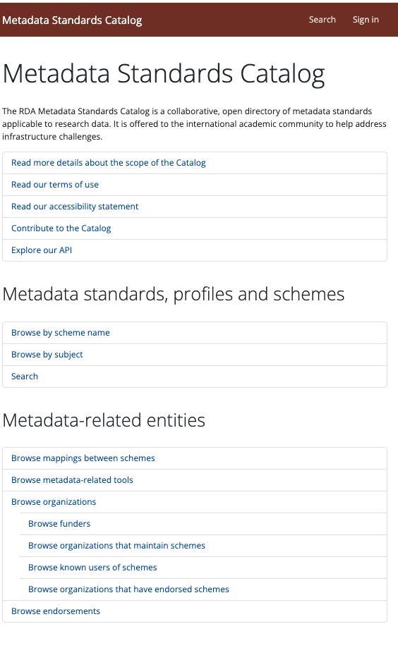
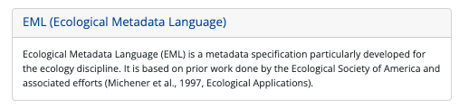
Which Metadata Standard?
rdamsc.bath.ac.uk
github.com/NCEAS/eml

Slide 24
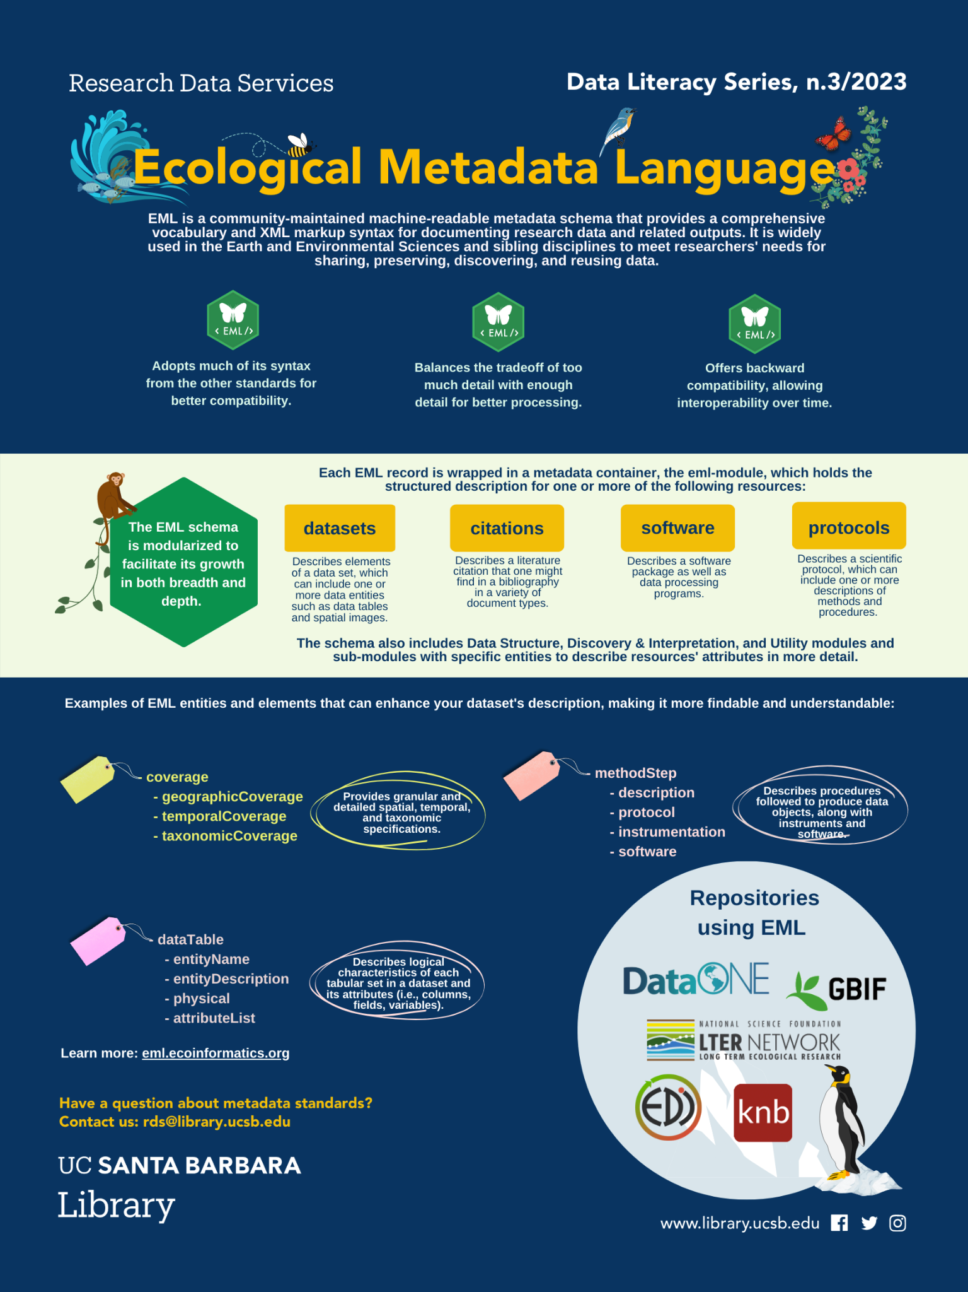
Current version EML 2.2.0
Developed at NCEAS
Compatible with other standards (DCMI, CSDGM/FGDC, ISO19115 )
A “dialect” for XML
  Modular
  Detailed structure
  Requires validation
Uses tags aligned with the requirements and needs from the ecology and environmental community
Used by some of the most relevant data repositories in the field
eml.ecoinformatics.org
perma.cc/E2TP-GXSX

Slide 25
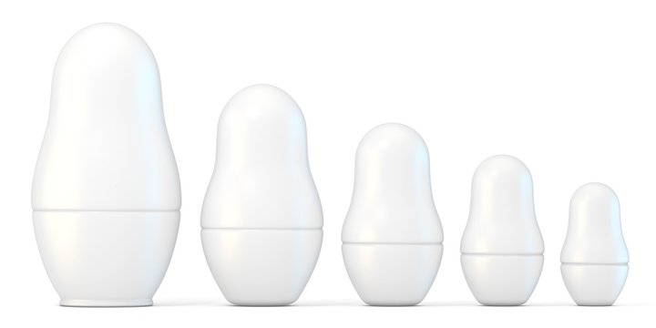

EML in XML
Uses flexible, custom tags to structure data
Human- and machine-readable format
Organizes data hierarchically to show relationships
Supports consistent data sharing across systems
Describes data only — does not process or compute it
EML Record
Dataset
Data Table
Attribute
List
Attribute

Slide 26

Minimum EML record
- eml
- dataset
- title*
- creator(s)*
- publisher
- pubDate
- keywords
- abstract
- intellectualRights
- contact*
- methods
- coverage (e.g., geographic/temporal/taxonomic)
- dataTable
- entityName
- entityDescription
- physical
- attributeList
*required fields

Slide 27
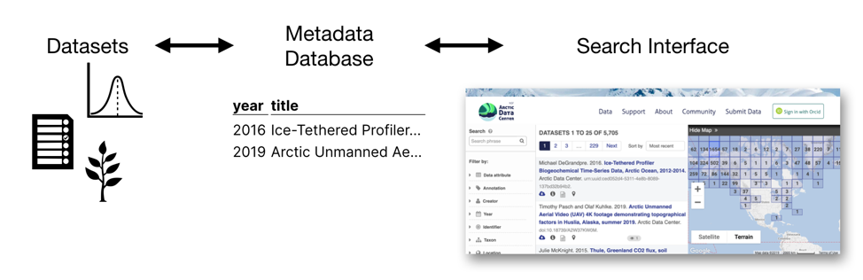
Metadata Standard in Action
Granular Search
More attributes of data become visible and searchable, while also maintaining greater consistency.
Choose to share your data in a repository that maintain rich queryable metadata
www.nceas.ucsb.edu/news/why-you-never-knew-how-much-you-needed-ecological-metadata-language

Slide 28
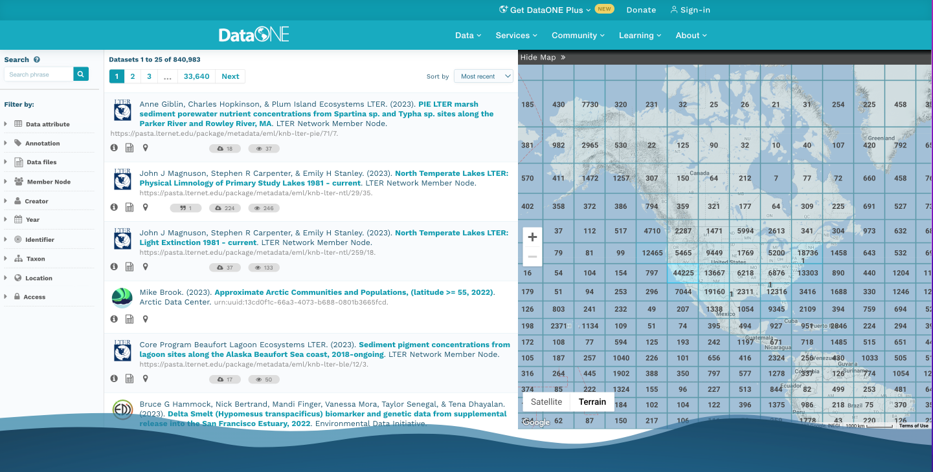
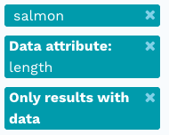
Metadata Standard In Action search.dataone.org/data

Slide 29
Creating an EML Record
Simple text editor (e.g., Atom) - painful! Only recommended for small edits
EzEML (EDI Web Form) - GUI for non-tech people, useful tool, but can be time consuming, lots of clicks!
An EML R package for data-savvys!

Slide 30
Recapping
Machine and human-readable metadata are essential for describing digital objects like datasets.
Without standard formats, inconsistent metadata hinders data discovery, comparison, and integration.
Standards like EML enable efficient data management and promote interoperability.

