Slide 1
Sensitive Data
(part II)
EDS213 - Databases & Data Management
Week 9
Renata Curty
Research Data Services, UCSB Library
rcurty@ucsb.edu
Notes:
Well-being (ethics), Bad actors, data misuse

Slide 2
Learning Objectives
Distinguish between direct and indirect identifiers and explain their role in privacy risk (cont’d)
Understand the applications of k-anonymity and l-diversity for protecting sensitive data
Apply remediation techniques using programmatic approaches

Slide 3
Sensitivity may not be always obvious
Sensitivity is not a fixed property of a single variable, it's an emergent property of the combination of fields × the population size × the richness of external data an adversary could link against.
Rare combinations of attributes (quasi-identifiers)
Data size and variability
Linkability to external datasets

Slide 4
Assessing Sensitivity
Identify
  Confidentiality risks (harm from unauthorized disclosure; legal/privacy violations)
  Integrity risks (impact of unauthorized changes or destruction)
  Availability risks (impact of delayed or inaccessible data)
Determine overall sensitivity level
  Low: Limited operational or individual impact
  Moderate: Serious operational disruption or significant harm
  High: Severe/catastrophic impact, including life-threatening consequences
Document risks, sensitivity classification and remediation steps
Establish access, sharing, and protection controls
DataONE Best Practices Working Group, DataONE (July 01, 2010) "Best Practice: Identify data sensitivity". Accessed through the Data Management Skillbuilding Hub at https://dataoneorg.github.io/Education/bestpractices/identify-data-sensitivity on Mar 01, 2024

Slide 5
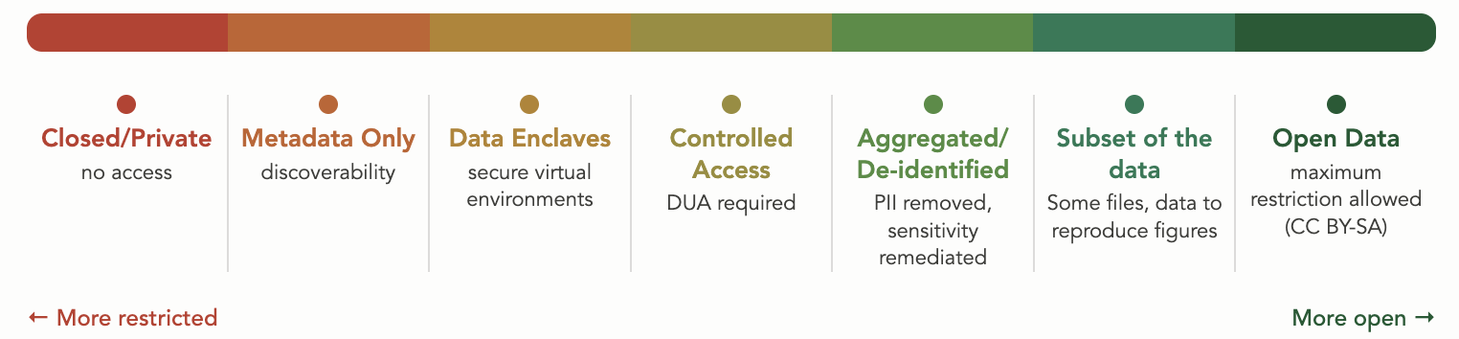
Data Sharing Continuum
Data sharing exists on a spectrum, with multiple options available depending on context, disclosure risk assessment, and purpose.
As open as possible, as closed as necessary
Protection measures
Granularity
Infrastructure

Slide 6
Dryad Archiving Policy (Sensitive Data)
No direct identifiers allowed
Maximum of three indirect identifiers per dataset (e.g., demographics, occupation, affiliations, or unique traits)
Assess whether combined identifiers could enable re-identification
Examples of re-identification risks: age, rare conditions, ethnicity, location, named facilities/services, uncommon characteristics
No access control
datadryad.org/docs/HumanSubjectsData.pdf

Slide 7




Disciplinary Repositories
Generally does not accept any sensitive data. Access restrictions, metadata only and permanent embargoes in exceptional cases
Follows applicable policies (IRB and CARE principles) and
adopts a data tagging system to label sensitivity levels
Researchers must comply with all federal, university, and Institutional Review Board policies, so as to not publish sensitive data. Supports access control.
Fully developed community guidelines with principles and practical approaches to remediate sensitivity prior to sharing/archiving. Adopts LocalContexts labels, which allows Indigenous communities to apply Traditional Knowledge or Cultural Heritage labels to define usage conditions.
EDI: edirepository.org/about/edi-policy#sensitive-data
Arctic Data Center: arcticdata.io/sensitive-data-guidelines
KNB: https://knb.ecoinformatics.org/about
GBIF: docs.gbif.org/sensitive-species-best-practices

Slide 8
Micro Data
Refers to granular, individual-level observations recorded at the finest unit of measurement
The single, atomic observation unit can be anything: a person, a sensor, a forest, a geological event, a tribe, a species…
You can always aggregate micro data upward, but you can't recover it from summary statistics (e.g, county-level average rainfall ≠ per-station hourly reading)
Presents higher disclosure risk

Slide 9
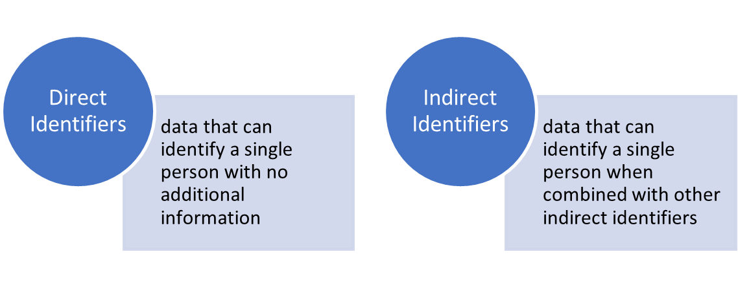



Direct vs Indirect Identifiers
Vulnerable Communities
Protected Lands
Endangered Species

Slide 10
How about other categories?
In EES spatial precision is the primary sensitivity driver
Vulnerable Communities
Protected Lands
Endangered Species
Direct Indirect
Exact coordinates
License and permit numbers (forestry, land, fisheries, farms, vehicles…)
Full addresses
Utility number account
Devices/Sensors and monitor devices IDs
Quasi-identifiers that combined can single out specific cases on a dataset
  Exact acreage or parcel size (e.g., 47.3 acres)
  Nearby geographic features (e.g., adjacent to a wetland or river bend)
  Ownership or management details (e.g., managed by a tribal conservation trust)

Slide 11
Redaction
(Suppression)
Randomization
(Swapping/Shuffling)
Pseudonymization
(Tokenization/Hashing)
Noising
(Disturbing)
Remediating Unwanted Disclosure
USUALLY A COMBINATION OF MULTIPLE METHODS
Removal of identifiers that can put subjects’ identities and privacy at risk.
Data for one or more variables are switched with another record, so that the data does not know whether the real data values correspond to certain records.
Slightly modification of the original dataset by applying techniques that round numbers and add random variation.
Meaningful piece of data are turned into a into an alias or a random string of characters which serves as reference to the original data, but cannot be used to guess those values.
Non-perturbative methods: reduces the detail or precision in the data with no distortion to the data structure
Perturbative methods: creates uncertainty around the true values
Recommended reading: https://doi.org/10.1136/bmj.c181

Slide 12
Mitigating the risk of unwanted disclosure
When a variable is considered an indirect identifier you may also consider:
Aggregation reduces the precision of the variable or the detail of its characteristics (e.g., recode zips to county name)
Top and bottom-coding instead of reporting exact numbers, it restricts the upper and lower range of a variable (e.g., 847 mg/L -> above regulatory threshold)
Collapsing and/or combining categorical variables merges two or more variables into a single category (e.g., tribal, recreational, and commercial fisheries -> non-commercial and commercial).
Bracketing/Categorization transforms continuous variables into categorical variables by reporting a variable range rather than its specific value (e.g., 4,732 mt -> 1,000–5,000 mt)
See: https://www.sjsu.edu/research/docs/irb-deidentification-techniques-table.pdf
Recommended reading: https://doi.org/10.1136/bmj.c181

Slide 13
Other Recommended Actions
Avoid sharing tables with small cell sizes (i.e., fewer than 5 cases/rows)
Be cautious when slicing the data into small subgroups or areas
Avoid listings of cases with outliers
Make sure to document the rationale behind the data transforms

Slide 14

NOT as anonymous as you think!
Dr. Latanya Sweeney (k-Anonymity)
~ 90% of the U.S. population could be easily identified by ZIP code, date of birth, and gender, in combination with any secondary health data sold by pharmacies and data analytics companies.

Slide 15

Massachusetts Group Insurance Commission “Anonymized Dataset”
It demonstrated that "anonymization" is often far weaker than assumed
Quasi-identifiers that aren't obviously sensitive but become powerful in combination
Laid groundwork for the field of data privacy and HIPAA’s Safe Harbor standard
Aka Governor Weld’s Experiment
Sweeney, L. (2002). k-anonymity: A model for protecting privacy. International journal of uncertainty, fuzziness and knowledge-based systems, 10(05), 557-570. doi.org/10.1142/S0218488502001648

Slide 16
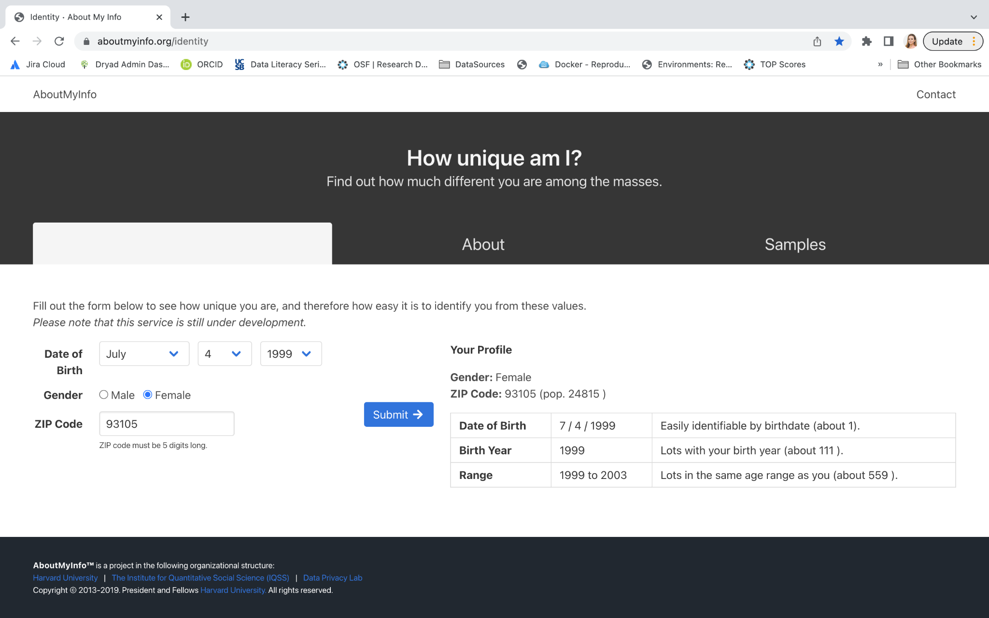
aboutmyinfo.org

Slide 17
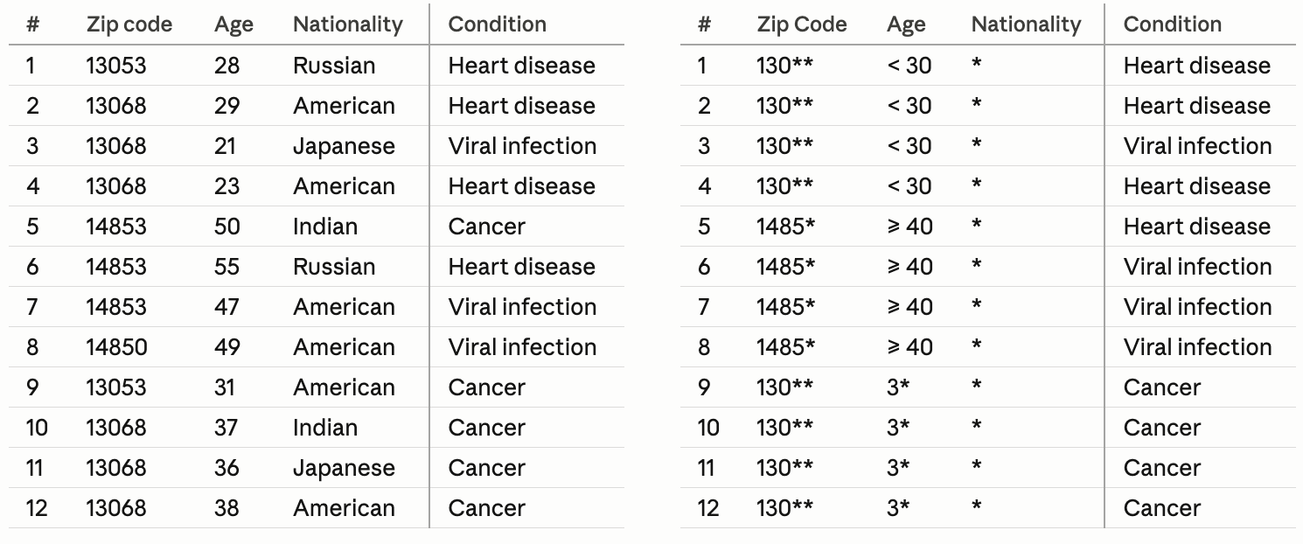
k-Anonymity
RISK ASSESSMENT AND MITIGATION
“Hiding in the crowd” approach
At least k rows in the dataset sharing the same set of attributes
Suppression + Global recoding/generalization
Samarati, P., & Sweeney, L. (1998). Protecting privacy when disclosing information: k-anonymity and its enforcement through generalization and suppression. https://dataprivacylab.org/dataprivacy/projects/kanonymity/paper3.pdf

Slide 18
k-Anonymity
THRESHOLDS
k=2 (bare minimum, rarely sufficient for real data)
k=3-5 (typical baseline for low-sensitivity data)
k=10+ (recommended for highly sensitive data, e.g., medical, financial)
k=50–100+ (large-scale publishing, i.e., census data)
Dataset size: small datasets need higher k because equivalence classes are easier to narrow down
Re-identification risk: how easy is it to link back to an individual given external data?
Adversary assumptions: what background knowledge might an attacker have?

Slide 19
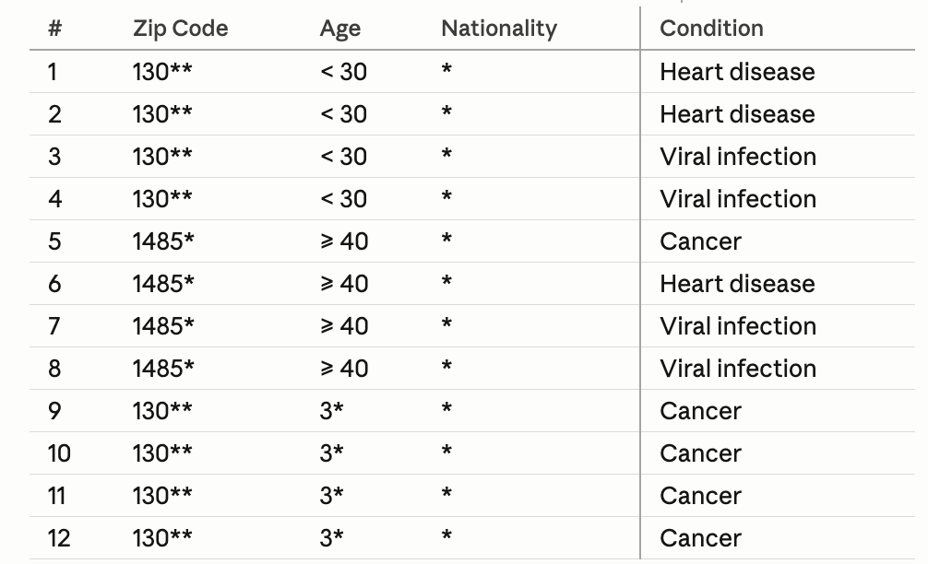
k-Anonymity
LIMITATIONS
Knowledge Attack
External or prior information that can help infer/single out cases
Homogeneity Attack
If all k records share the same sensitive value, an attacker learns that value with 100% certainty
Homogeneity Attack
k-anonymity only protects quasi-identifiers, not sensitive values.
An attacker can still infer sensitive attributes about a given case.

Slide 20
Application beyond HS data
Corporate/facility data: emissions records, discharge permits, or inspection reports tied to specific companies or industrial sites
Species location data: k-anonymity-style spatial generalization
Sensor/IoT data: used to prevent re-identification of individual sensors that can be reverse-engineered to identify a person's home or behavior
Relevant wherever records can be linked back to identifiable entities and disclosure would cause harm

Slide 21
Region code | Elev. (m) | Land use | Lat | Long | Pollutant
CA-042 | 312 | urban | 37.4419 | -122.143 | NO2
CA-047 | 285 | suburban | 37.3861 | -122.0839 | NO2
CA-041 | 340 | agricultural | 37.5485 | -121.9886 | PM2.5
CA-049 | 298 | forest | 37.2502 | -121.8363 | PM2.5
NV-013 | 1210 | desert | 39.5296 | -119.8138 | Ozone
NV-018 | 1450 | rangeland | 39.1638 | -119.7674 | Ozone
NV-011 | 1320 | urban | 39.321 | -119.6442 | SO2
NV-015 | 1180 | suburban | 39.4774 | -119.9702 | SO2
OR-082 | 154 | forest | 45.5231 | -122.6765 | Pb
OR-087 | 178 | wetland | 45.4871 | -122.804 | Pb
OR-084 | 163 | suburban | 45.6051 | -122.5315 | NO2
OR-089 | 191 | urban | 45.423 | -122.7431 | NO2
Pre-assessment
Anticipate potential harm/risks
Remove direct identifiers
Identify sensitive attributes (dependent variables)
Identify quasi-identifiers
Consider ways to remediate to mitigate risk

Slide 22
Region code | Elev. (m) | Land use | Lat | Long | Pollutant
CA-042 | 312 | urban | 37.4419 | -122.143 | NO2
CA-047 | 285 | suburban | 37.3861 | -122.0839 | NO2
CA-041 | 340 | agricultural | 37.5485 | -121.9886 | PM2.5
CA-049 | 298 | forest | 37.2502 | -121.8363 | PM2.5
NV-013 | 1210 | desert | 39.5296 | -119.8138 | Ozone
NV-018 | 1450 | rangeland | 39.1638 | -119.7674 | Ozone
NV-011 | 1320 | urban | 39.321 | -119.6442 | SO2
NV-015 | 1180 | suburban | 39.4774 | -119.9702 | SO2
OR-082 | 154 | forest | 45.5231 | -122.6765 | Pb
OR-087 | 178 | wetland | 45.4871 | -122.804 | Pb
OR-084 | 163 | suburban | 45.6051 | -122.5315 | NO2
OR-089 | 191 | urban | 45.423 | -122.7431 | NO2
Actions
Suppression
Collapsing and/or combining categorical variables
Bracketing/ Categorization

Slide 23
Region code | Elev. (m) | Land use | Pollutant
CA-04* | <400 | urban | NO2
CA-04* | <400 | urban | NO2
CA-04* | <400 | urban | PM2.5
CA-04* | <400 | non-urban | PM2.5
NV-01* | >1000 | non-urban | Ozone
NV-01* | >1000 | non-urban | Ozone
NV-01* | >1000 | urban | SO2
NV-01* | >1000 | urban | SO2
OR-08* | <200 | non-urban | Pb
OR-08* | <200 | non-urban | Pb
OR-08* | <200 | urban | NO2
OR-08* | <200 | urban | NO2
Remediated/
Shareable Dataset

Slide 24
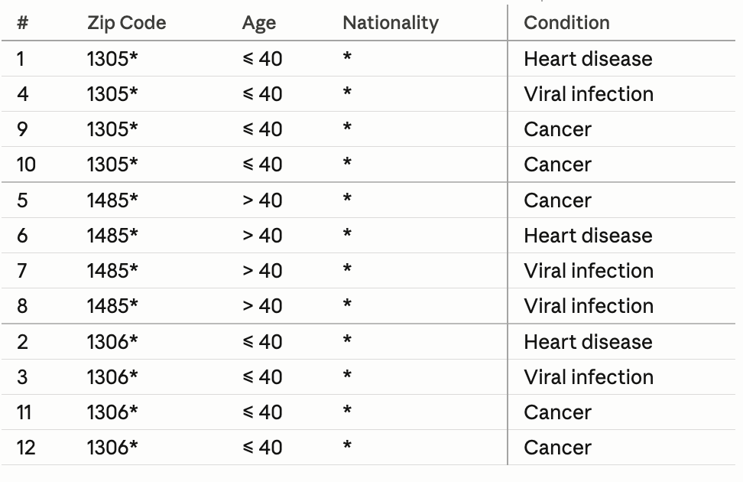
l-Diversity
Goal: Ensure sensitive attribute diversity
An extended privacy property that measures the diversity of sensitive values within each column of a dataset.
For any group of rows with identical quasi-identifiers, there must be at least l distinct values for each sensitive attribute.
Makes it harder to identify specific sensitive values associated with individuals or smaller groups within the dataset.
Machanavajjhala, A., Kifer, D., Gehrke, J., & Venkitasubramaniam, M. (2007). l-diversity: Privacy beyond k-anonymity. ACM Transactions on Knowledge Discovery from Data (TKDD), 1(1), 3-es. https://doi.org/10.1145/1217299.1217302
Gehrke, J., Kifer, D., Machanavajjhala, A. (2011). ℓ-Diversity. In: van Tilborg, H.C.A., Jajodia, S. (eds) Encyclopedia of Cryptography and Security. Springer, Boston, MA. https://doi.org/10.1007/978-1-4419-5906-5_899

Slide 25
Knowledge Check
Case | Zip | Year Built | Property Type | Floor Level | Claim Amount
001 | 12345 | 1995 | Apartment | 1st | $12,000
002 | 12346 | 1995 | Apartment | 2nd | $15,000
003 | 12347 | 2000 | House | Ground | $20,000
004 | 12348 | 2000 | House | Ground | $22,000
005 | 12349 | 1990 | Apartment | 2nd | $11,000
006 | 12346 | 1995 | Apartment | 1st | $14,000
Which variable contains sensitive data?
How many quasi-identifiers are present in this dataset?
Does this dataset violate k-anonymity assumption?
How could we mitigate disclosure risk?

Slide 26
Knowledge Check
Case | Zip | Year Built | Property Type | Floor Level | Claim Amount
001 | 123** | 1990–1999 | Apartment | Low | $12,000
002 | 123** | 1990–1999 | Apartment | Low | $15,000
003 | 123** | 2000–2009 | House | Ground | $20,000
004 | 123** | 2000–2009 | House | Ground | $22,000
005 | 123** | 1990–1999 | Apartment | Low | $11,000
006 | 123** | 1990–1999 | Apartment | Low | $14,000
Does this version of the dataset satisfy l-diversity?

Slide 27
Programmatic Remediation
Notes:
Well-being (ethics), Bad actors, data misuse

Slide 28

Tools (Quantitative Data)
Many existing tools, supporting different de-identification techniques/methods.
sdcMicro package
R-based (open and free)
Robust and widely used/cited
Reproducibility!
Recommended reading: https://doi.org/10.1136/bmj.c181

Slide 29
Statistical Disclosure Control
SDC is a method for risk estimation and adjustment considering the utility of the data, having responsible and ethical data sharing in mind.
A three-step process:
Assess the risk of re-identification
Reduce the risk of re-identification
Quantify information loss
∝
Disclosure Risk
Data Utility

Slide 30
sdcMicro (anonymized microdata for public and scientific use)
Method | Classification | Data Type
Global recoding | non-perturbative, deterministic | continuous and categorical
Top and bottom coding | non-perturbative, deterministic | continuous and categorical
Local suppression | non-perturbative, deterministic | categorical
PRAM | perturbative, probabilistic | categorical
Micro aggregation | perturbative, probabilistic | continuous
Noise addition | perturbative, probabilistic | continuous
Shuffling | perturbative, probabilistic | continuous
Rank swapping | perturbative, probabilistic | continuous
https://cran.r-project.org/web/packages/sdcMicro/sdcMicro.pdf
https://sdcpractice.readthedocs.io/en/latest/sdcMicro.html
Recommended reading: https://doi.org/10.1136/bmj.c181

Slide 31
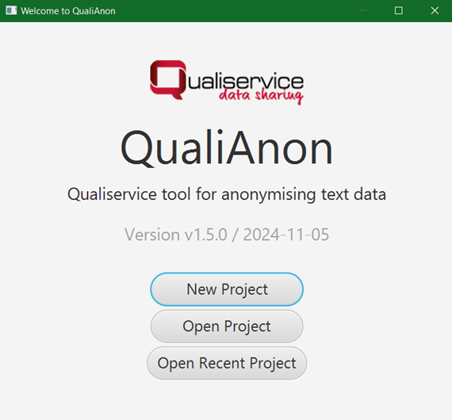


Tools (Qualitative Data)
Named Entity Recognition (NER)
github.com/jftuga/ deidentification
qdr.syr.edu/guidance/
human-participants/ deidentification
github.com/pangaea-data-publisher/ qualianon

Slide 32
Closing Thoughts
Datasets can undergo de-identification and anonymization processes while still being shareable and reusable.
Sensitive data can still be safely shared among trusted partners or using controlled access.
During the de-identification process, it is essential to strike a balance between preserving the utility of the dataset and minimizing information loss.
We can use programmatic methods to safely remediate sensitive datasets.

Slide 33
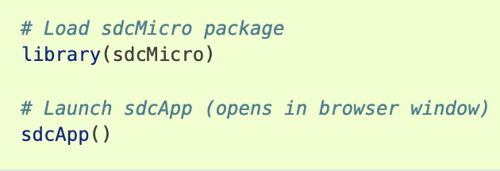
Let’s Practice!

