Slide 1
Data Publication
EDS213 - Databases & Data Management
Week 10
Renata Curty & Greg Janée
Research Data Services, UCSB Library
rds@library.ucsb.edu

Slide 2
Previously on EDS-213
Data is copyrightable only as compilations under certain conditions
Data, databases, and software are considered separate entities
Not all data can be public domain, but if federally funded and no exemption applied, you can request it
Data produced can be commercialized under data license agreements. Read them carefully!
Databases and code can be subject to copyright, but in academia, open licenses are more commonly considered
Creative Commons (CC) licenses should not be used for software/code
Many repositories operate under CC0 for data, but attribution is still endorsed

Slide 3
Learning Objectives
Understand the importance of publishing research data
Identify and select appropriate approaches to data publication
Experience the importance of documentation

Slide 4
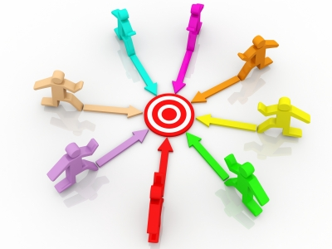
For Science
For You
For Collaborators
Motivation: Open & Reproducible
Cornerstone of science efficacy
More robust science
Increased public confidence in the scientific process
Speed up discovery by building on others work / findings
Iterate more quickly
Integrate new information more easily
Better collaborate
Understand
Provide feedback
Contribute

Slide 5
Research data lifecycle
Repositories
PIds
Licensing
Standards
Roles & responsibilities
DMP and DMPTool
Publish
& Share
Plan
Metadata & ReadMe
Version control
Backup
Document
& Store
Project organization
File naming
Tidy data
Collect & Analyze
Notes:
– Jairo
Research data lifecycle

Slide 6
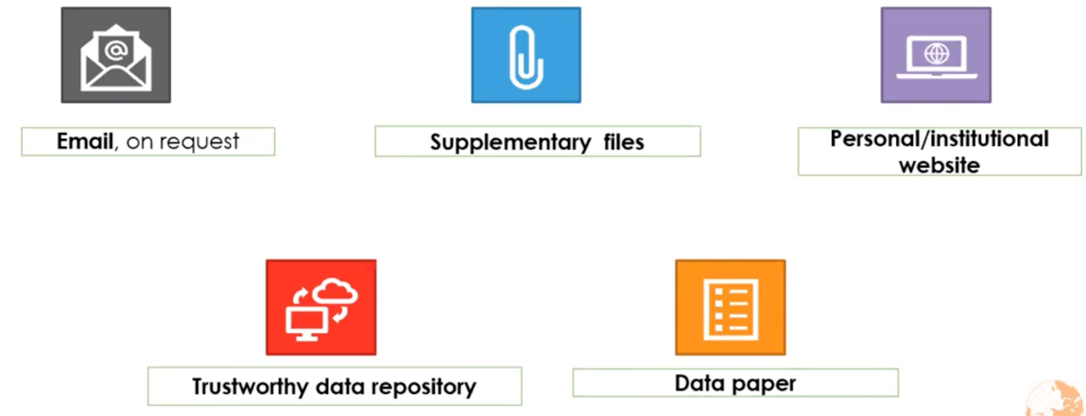

Data Sharing/Publication

Slide 7
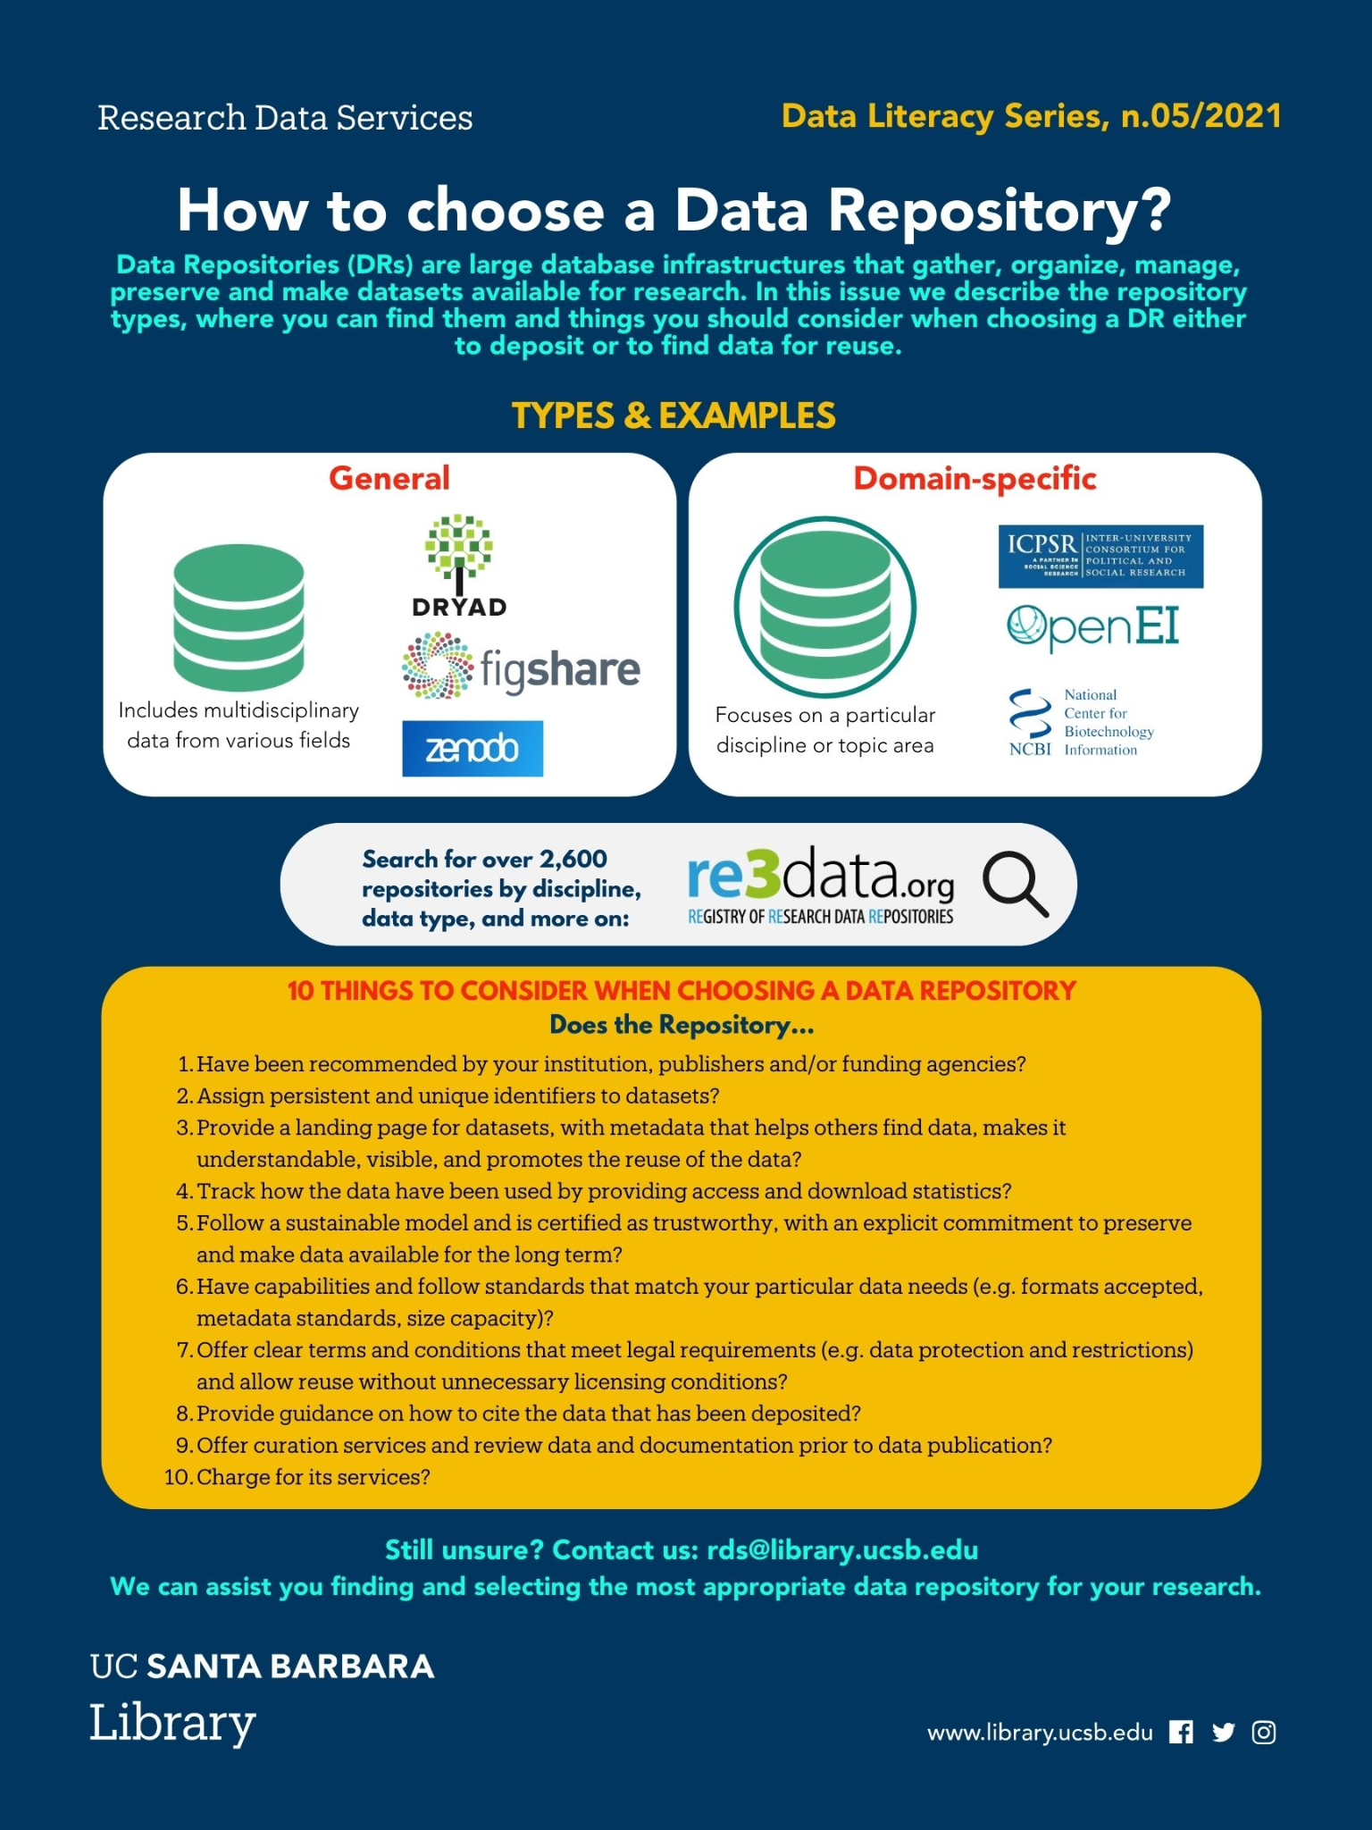
Why a Data Repository?
You can’t lose data that’s in a public data repository
They support understanding, reanalysis and reuse
Data repositories facilitate discovery
Open data demonstrates transparency and rigor
Citations

Slide 8
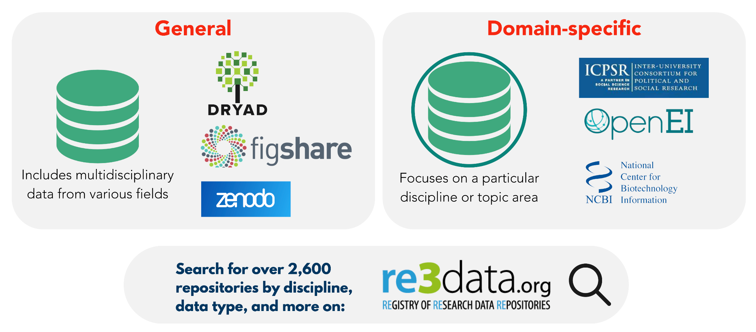



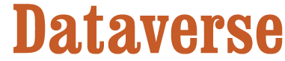




Data repositories
Derived from Data Literacy Series n.05/2021
Notes:
Why a data repository?
You can’t lose data that’s in a public data repository
Public data repositories support understanding, reanalysis and reuse
Public data repositories facilitate discovery
Public data demonstrates rigor
Research with data in public data repositories attracts more citations
Examples of generalist repositories
Dryad: A curated data publishing platform for researchers to share and publish their data. Free for UC affiliates.
Zenodo: general-purpose open repository for various research outputs (research papers, datasets, software, reports, etc)
Figshare: Contains many supplemental data sets from published articles.
Dataverse: an open source web application to share, preserve, cite, explore and analyze research data.
Examples of domain Specific repositories
Gene Expression Omnibus (GEO): “archives functional genomics data repository that archives open-access array- and sequence-based datasets.”
The Cancer Imaging Archive (TCIA): “de-identifies and publishes medical image datasets to study cancer.”
Database of Genotype and Phenotype (dbGaP): “archive and distribute the data and results from studies that have investigated the interaction of genotype and phenotype in humans.”
Protein Data Bank (PDB): “sustain a unique data resource of three-dimensional biomolecular structure information”
Finding a repository
Give preference to repos relevant to your field/discipline and those recommended by publishers and funding agencies
Registry of Research Data Repositories (Re3data): a repository of data repositories
NIH webpage on selecting a data repository with information on repository characteristics and other considerations
NIH supported data sharing resources with information on generalist repositories and domain-specific repositories
=================
Repositories provide technical infrastructure to provide access and curation of research data. They provide a persistent identifiers and a citation for your data. Thus, depositing data in a repository promote the long-term preservation, sharing, and reuse of your data
For some programs and types of data, NIH or others might identify particular data repositories (or sets of repositories) to be used to preserve and share data. Otherwise, researchers are encouraged to select a data repository that is appropriate for the data type and the discipline
Other
UniProt

Slide 9
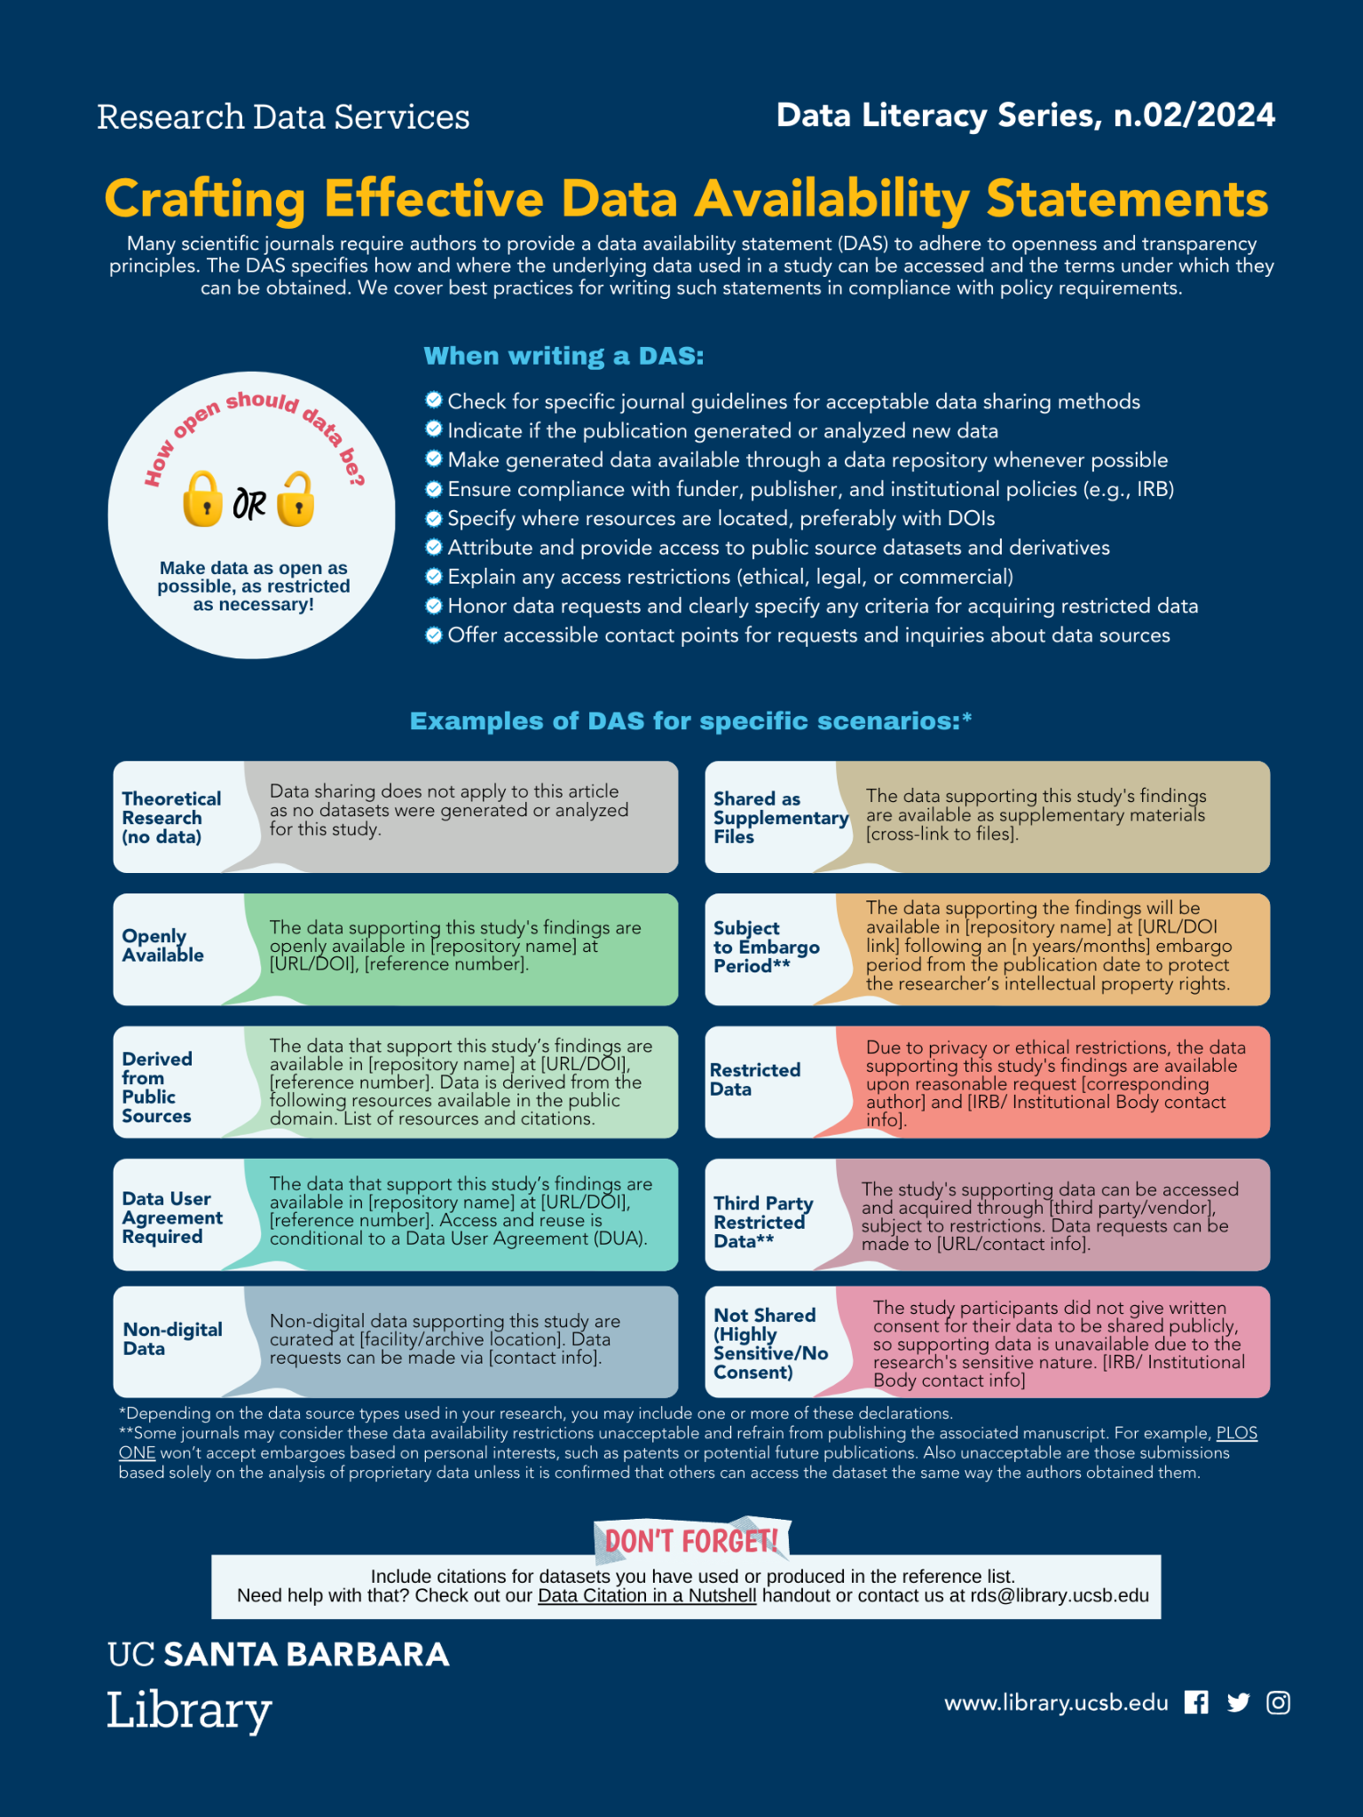
More on Best Practices
Add a data availability statement to related publications and deliverables (even if not required)
Explain any access restrictions (ethical, legal, or commercial)
Honor data requests and clearly specify any criteria for acquiring restricted data
Offer accessible contact points for requests and inquiries about data sources

Slide 10
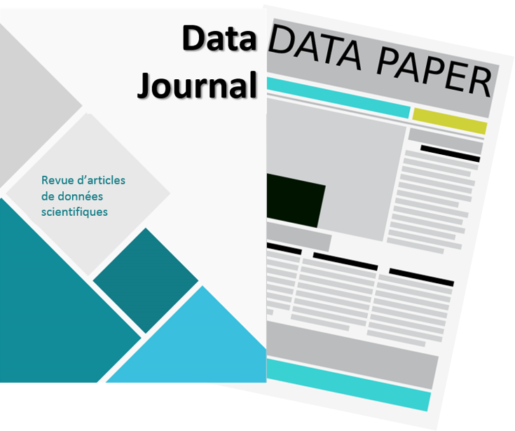
Consider a Data Paper
Data papers can help elevate the visibility of project data promoting the culture of openness and collaboration, while also providing the more traditional incentives for academics.
Not mutually exclusive; the data archive remains relevant
Can be published in dedicated Data Journals or journals that accept this category of submission
List of Relevant Data Journals in Biodiversity: https://www.gbif.org/data-papers
https://www.enago.com/academy/should-you-publish-your-research-data-the-new-trend-of-data-journals

Slide 11
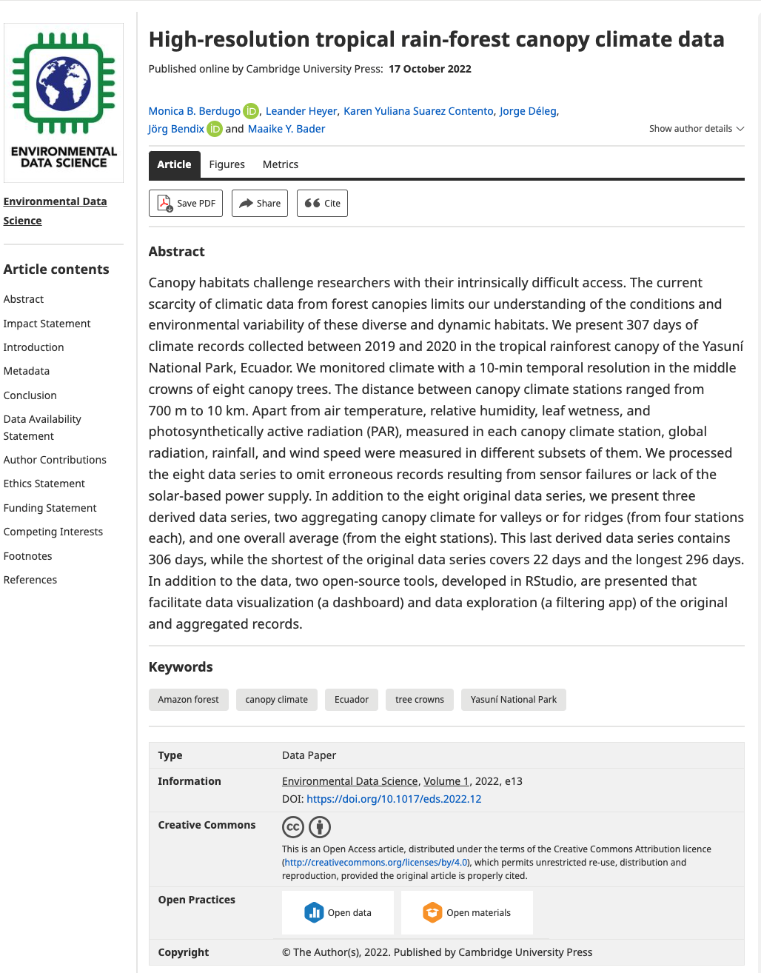
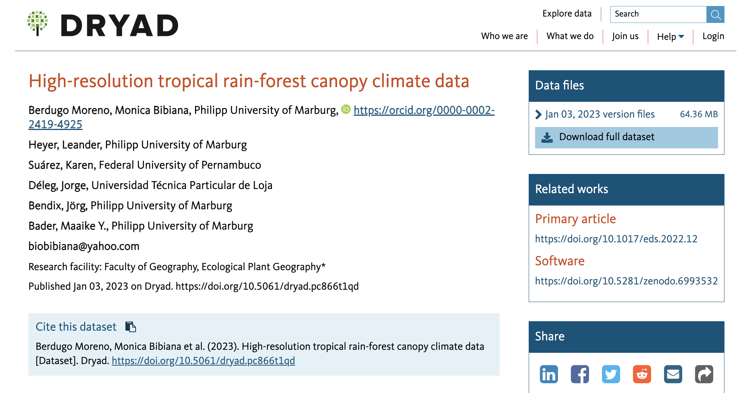
Data Papers
Cross-referenced, using persistent identifiers.
https://doi.org/10.5061/dryad.pc866t1qd
https://doi.org/10.1017/eds.2022.12

Slide 12
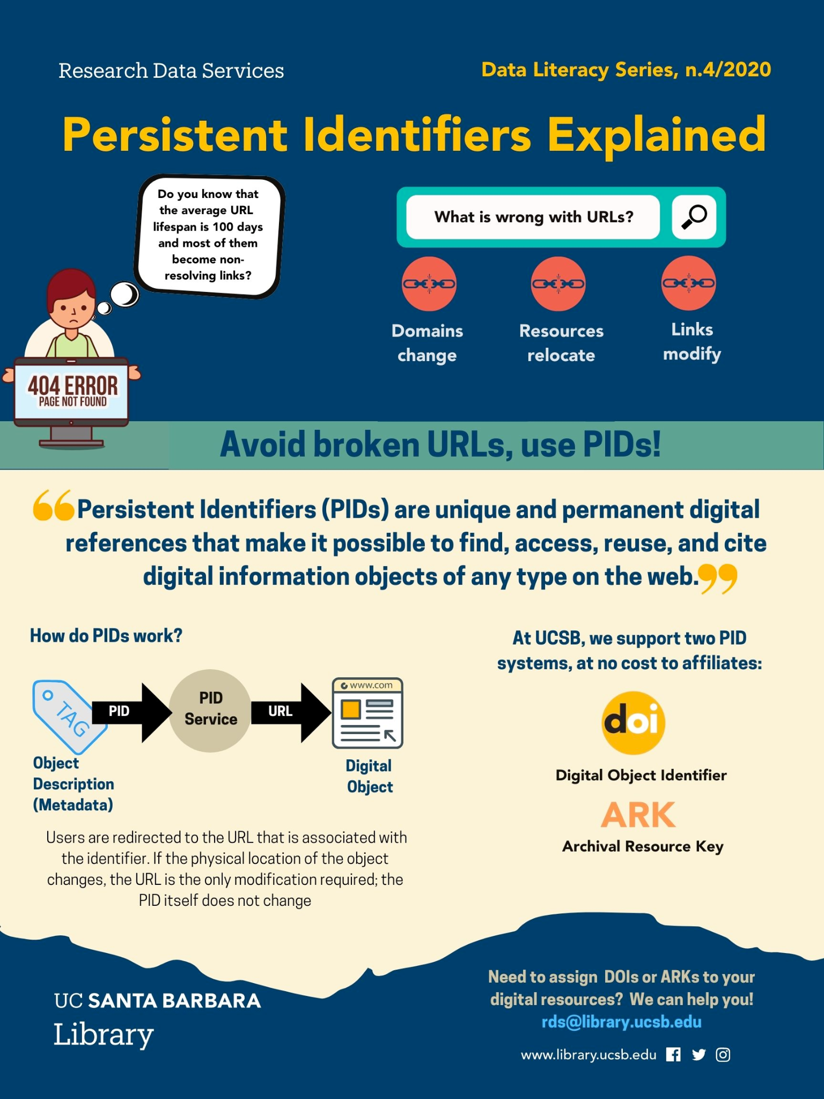
Persistent Identifiers
Most repositories will mint a PId to datasets!
Most journals will mint a PId for papers!
Some repos such as Zenodo and Figshare also create PIds for a variety of other scholarly digital objects (slides, images, code/software)
Released repos on GitHub are assigned a DOI via a Zenodo integration (let’s see how it works!)
404

Slide 13

Why Publish your Capstone Data?
A safe place
To archive
your work
requirements
You will be soon loosing access to your UCSB resources!!!
For your
portfolio!
Accountability!
Notes:
So why should you publish your GP data?
A data repository is a safe place to archive your data, independent of your current institution. You will be graduating and thus losing access to your Bren computing resources
It adds to your portfolio you can showcase during job interviews. Data archive get a DOI and thus can be added to your CV under publications
On the stick side, well it is a GP requirements for your graduation

Slide 14
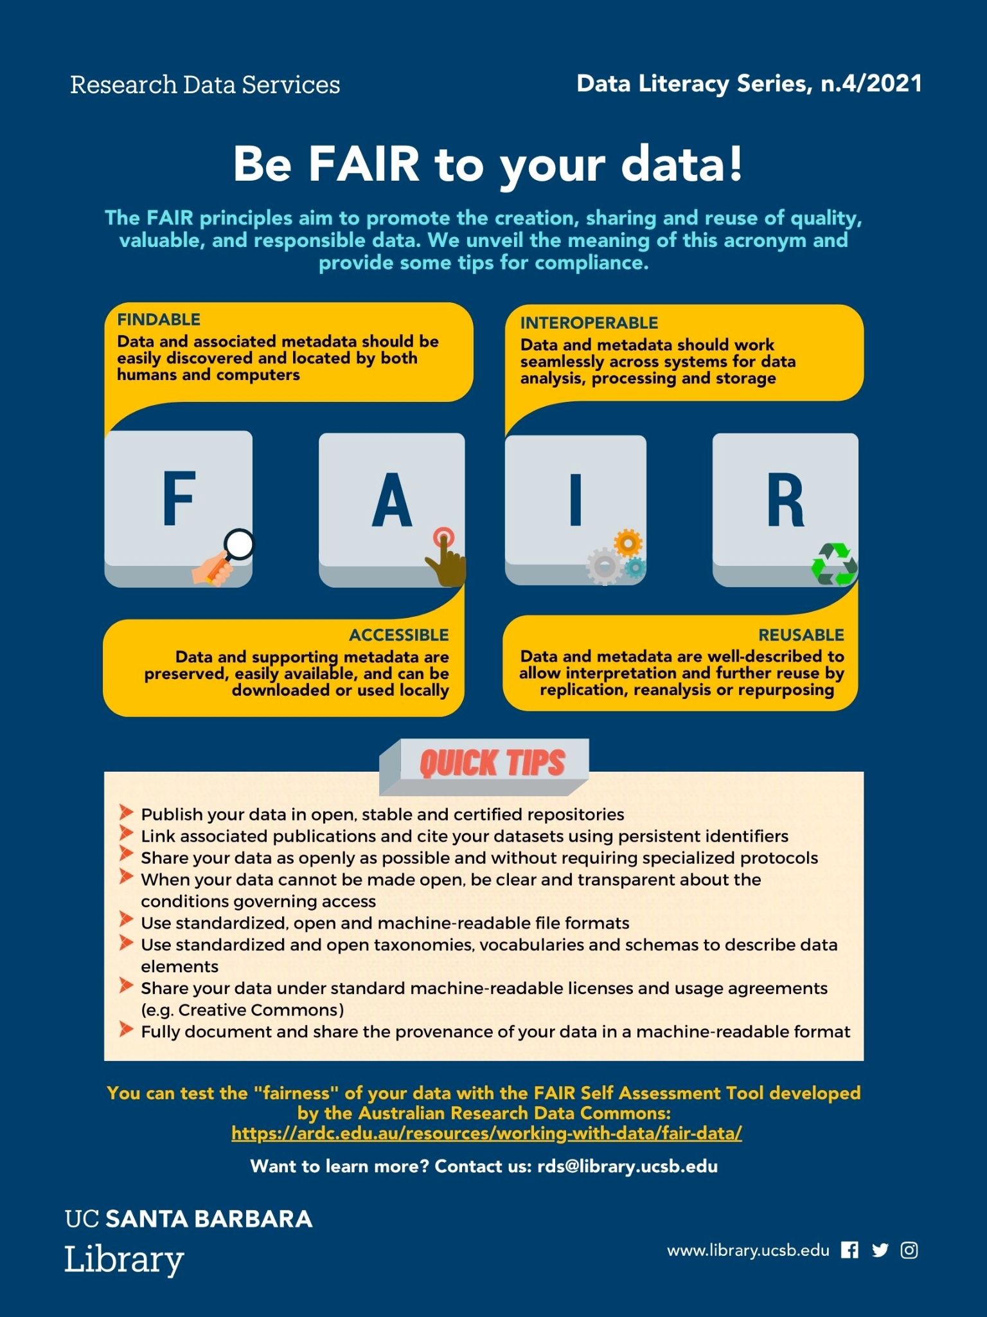
Making your data FAIR
Well-documented (README + metadata)
Open format
With link to the associated code
With an explicit license
In a stable repository
With a persistent identifier

Slide 15
Good Documentation
Includes:
A shared & defined vocabulary
Your future self and others will rely on it
Should avoid ambiguities
It requires time and iterations
=> Develop documentation when things are fresh in your mind,
make it part of your research workflow!
Notes:
— RENATA starts here —

Slide 16
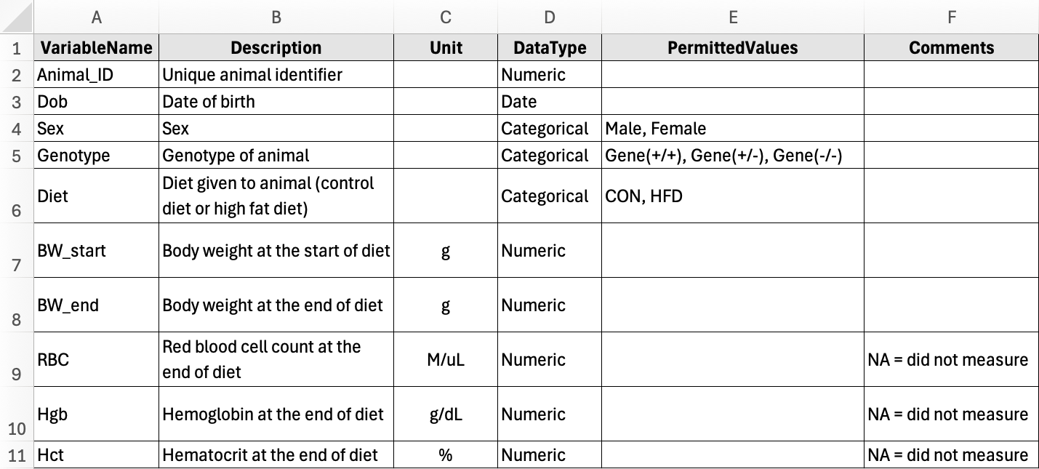
Data dictionary
Notes:
Elements of a data dictionary
VariableName: variable (i.e., column headers) that appear in the dataset
Title: full title of the variable
Unit: unit of measurement (if applicable)
Description: definitions and descriptions of the variable. The description should explain what the variable represents in enough detail such that a reader can understand the contents of the column in the dataset.
DataType: specify whether the variable contains Numeric, Categorical, Ordinal, Date, or Free Text data
PermittedValues: if the variable is categorical or ordinal, list all possible values here
MinValue: If the variable is numeric, list the minimum possible value
MaxValue: If the variable is numeric, list the maximum possible value
Comments: Additional notes such as exclusion criteria, reasons for special values, etc

Slide 17

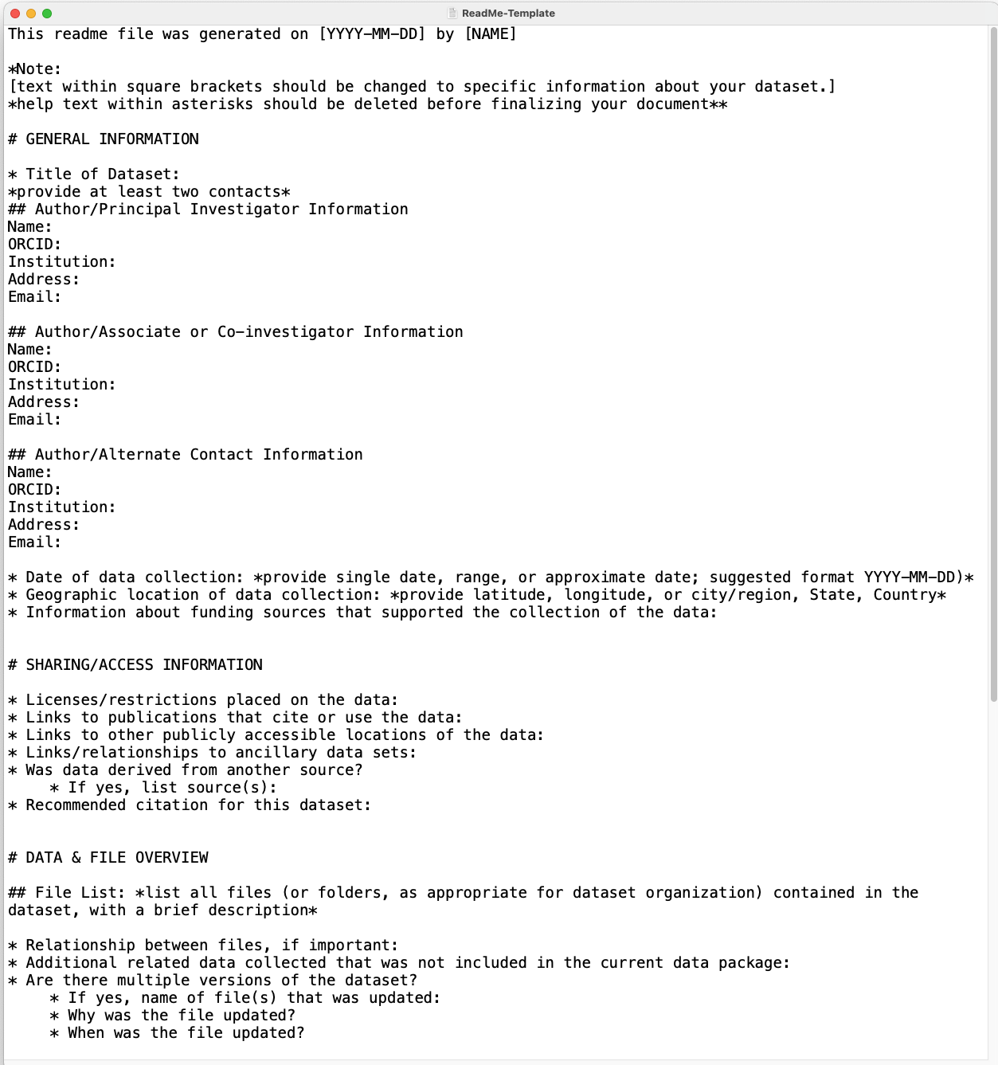
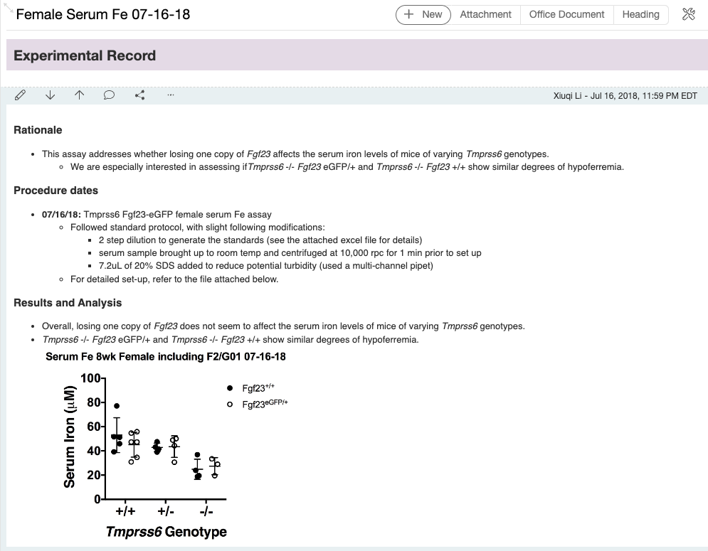
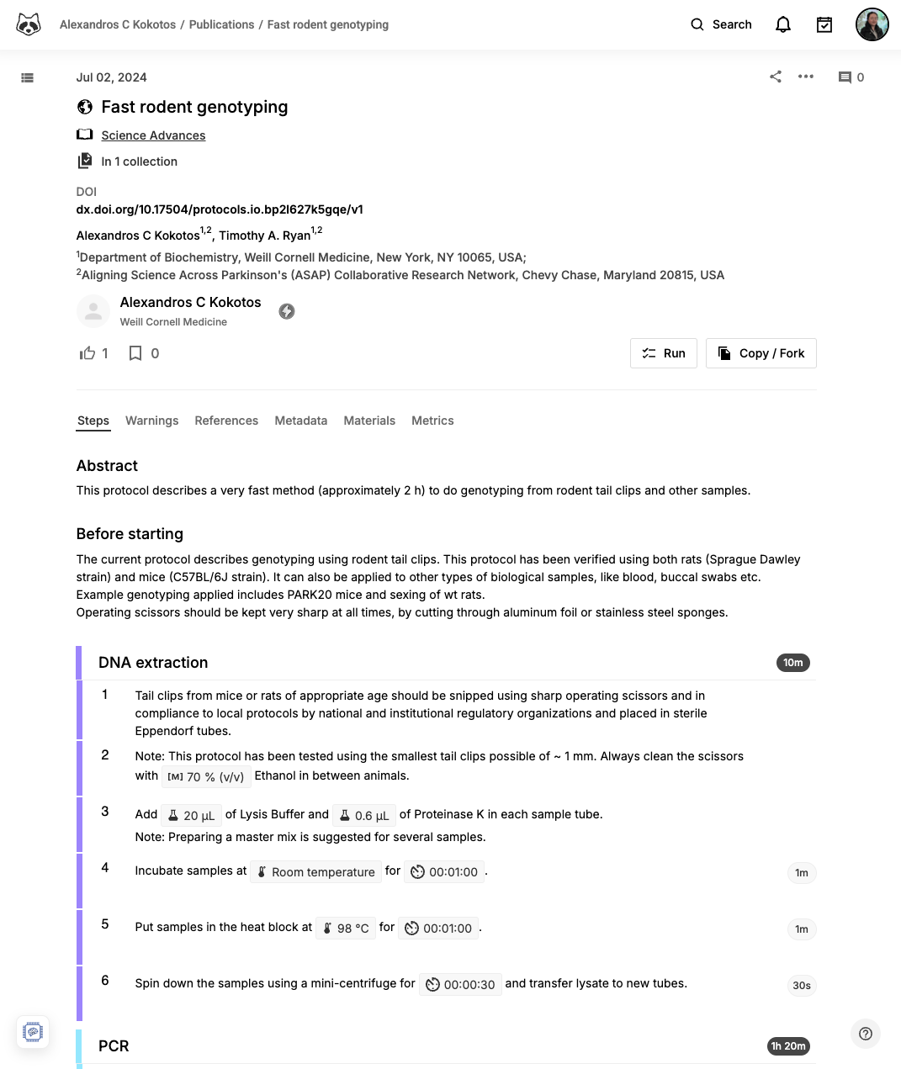
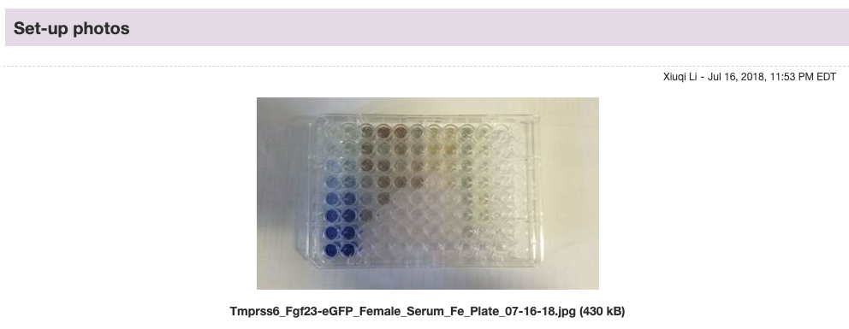
Documentation formats
ReadMe
Notebook
Protocols
Screenshot of Kozlowski 2025.
Screenshot of Li 2018. Platform: LabArchive.
Screenshot of Kokotos 2024
See Data Literacy Series n.3/2021 re ReadMe and 11/2024 re Protocols.io
Notes:
Transition: Collaborative tools -> version control

Slide 18
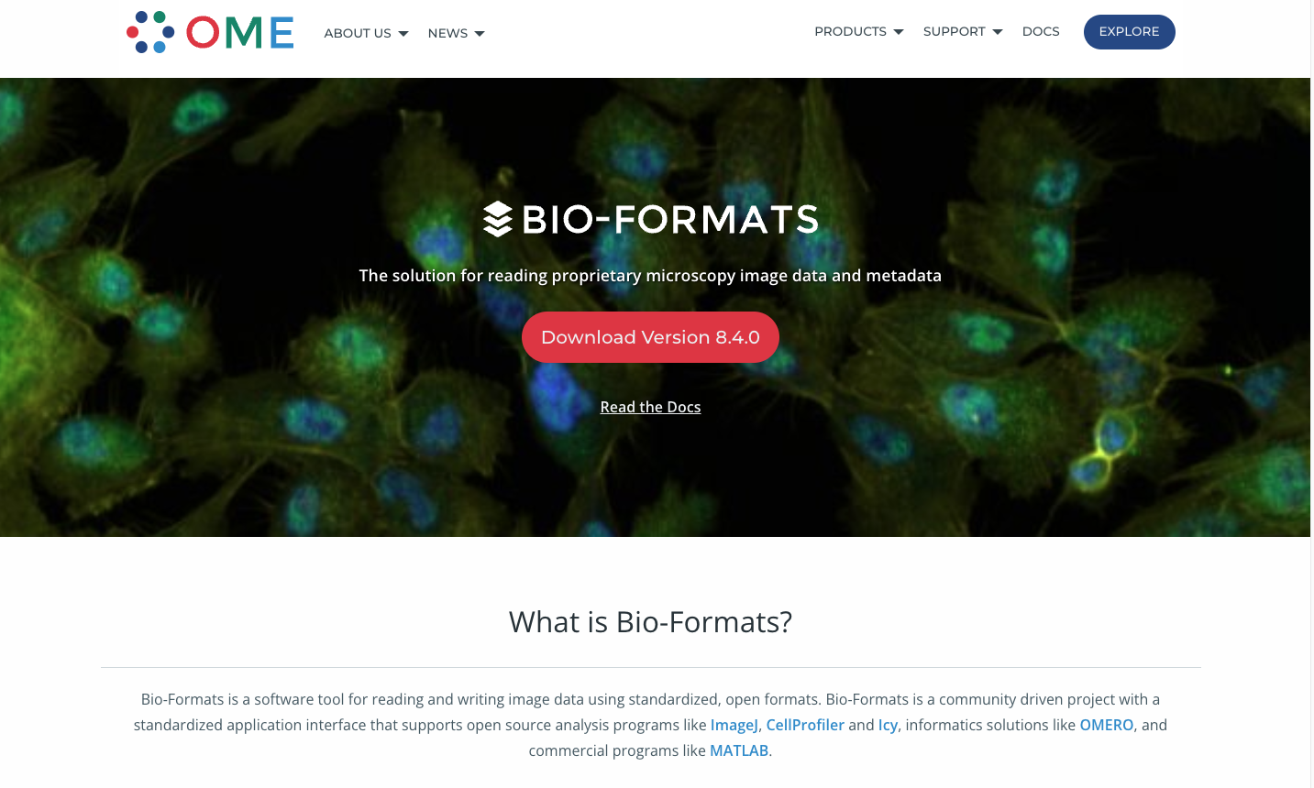
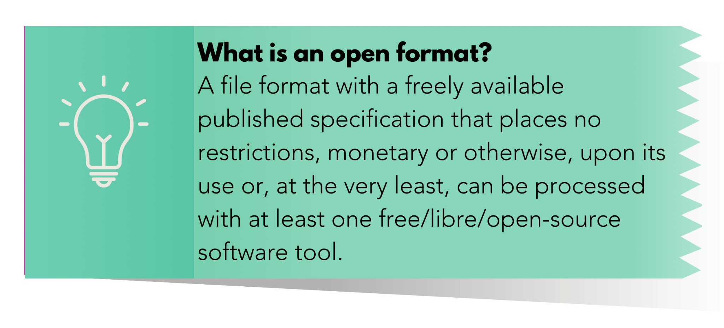
Open file format
e.g., open formats: PNG, TIFF, OME-TIFF
proprietary formats: PSD, Zeiss CZI, Leica LIF
https://www.openmicroscopy.org/bio-formats/
** Preserve the original proprietary file (for metadata integrity), and create an open, well-documneted version for publication and sharing.
Left screenshot from UCSB Data Literacy Series (Jul 2021)

Slide 19
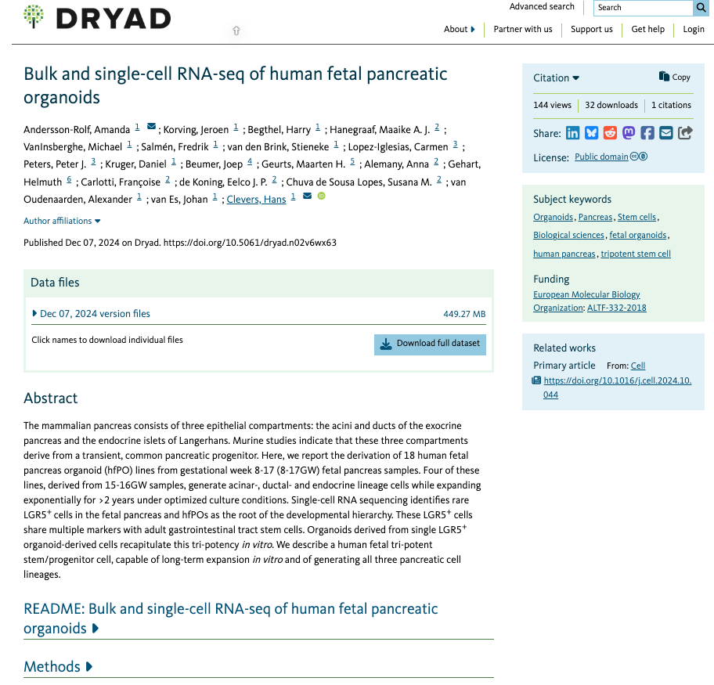
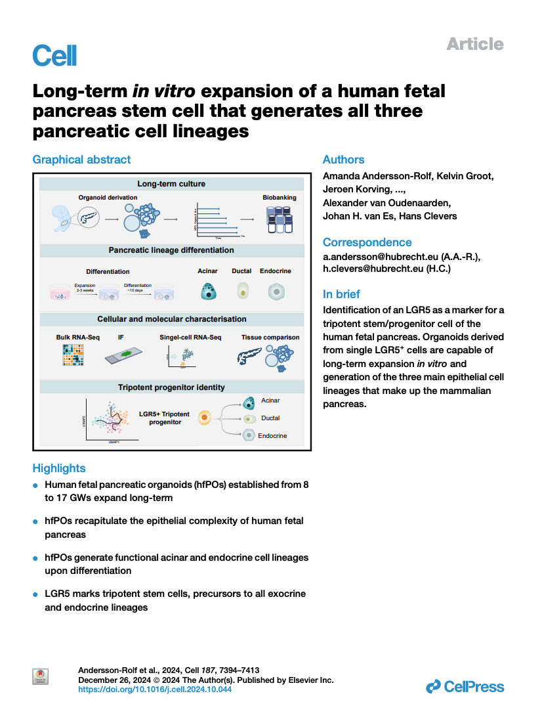
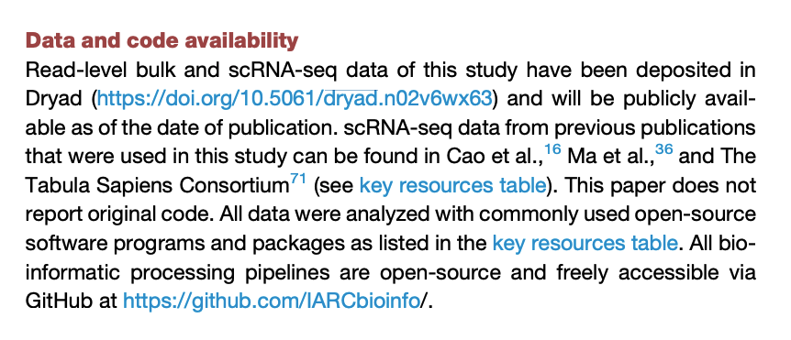
Dryad – a data repository solution supported by the UC
See Data Literacy Series n.4/2022 for more info re Dryad
Notes:
Dryad example
Unique and persistent identifiers: to support data discovery, reporting, and research assessment. In this case, a doi or digital object identifier, that the authors link to directly in their publication
Metadata: datasets are accompanied by metadata to enable discovery and reuse. In this case, a ReadMe section providing detailed information re the data files e.g., format, sequencing methods, variables
Curation and quality assurance: For Dryad, data curators will check your files before they are released to help you follow best practices
Clear use guidance: provides accompanying documentation describing terms of dataset access and use. In this case, a public domain, cc0 license

Slide 20

Contact us:
rds@library.ucsb.edu
Group Project Data Management Website
https://ucsb-library-research-data-services.github.io/project-data-management/

Slide 21
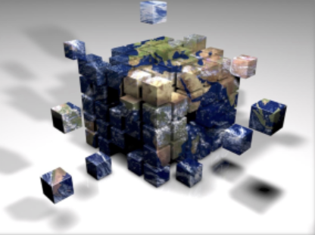
What is being an
(Environmental) Data Scientist ?

Slide 22
It is mostly a
State of mind
Notes:
Mostly a state of mind about problem solving

Slide 23
It is mostly a
State of mind
Know- ledge
Skills
Notes:
This state of mind build on two main pillars: Knowledge and skills

Slide 24
It is mostly a
State of mind
Know- ledge
Skills
Knowledge
is resilient
Skills are dynamic
Notes:
Those two pillars have a big difference: one is resilient the other is more dynamic

Slide 25
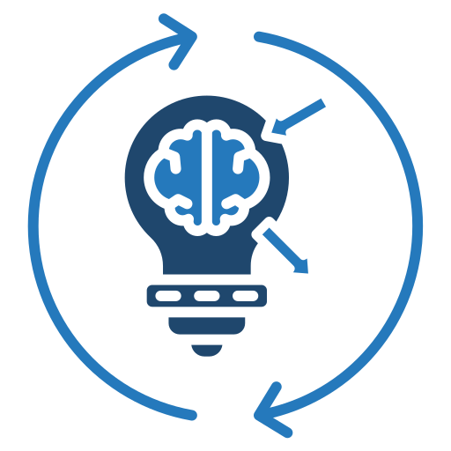

Reflection exercise
What are 1 or 2 things you might want to consider changing or implementing while finalizing your data preservation?
Image from Flaticon
Notes:
A lot of the recommended practices and tools we shared today may take some time to adapt and implement into your workflow. And it can seem overwhelming trying to do everything immediately. Consider slowly and gradually increase your adoption depending on the nature and scope of your project.

